Slide 1
"The cluster is the runtime — if it is not in the image, it does not exist."
SUPPLEMENTARY · MODULE 10
Containers and
Red Hat OpenShift
Package and run services on OpenShift: images, probes, ConfigMaps, routes, and the platform primitives that replace localhost assumptions.
📦
☸️
🔴
🚀
SPRING BOOT MICROSERVICES BOOTCAMP • DAY 4 • MODULE 10
Notes:
KEY TALKING POINTS
------------------
- Framing Module 10
Tell the room what changes today.
Until now every service ran on localhost, with ports 8081 and 8082 on the lab VM and passwords in a local Compose file.
Module 10 replaces each of those assumptions.
The JAR goes into a non-root container image.
Configuration moves into ConfigMaps and passwords into Secrets.
Other services find Account Service by its Service name, and clients reach it through an HTTPS Route.
The module starts with container fundamentals and builds toward OpenShift objects.
- Link to Module 9
The probes and correlation ids from Module 9 are what make a container manageable.
OpenShift cannot restart a hung pod or hold traffic from a starting one unless the app answers liveness and readiness.
Engineers cannot follow a request across two pods unless correlationId= survives containerisation.
Remind learners that Lab 4 checks both, first on Docker Compose on the VM and then on their assigned ARO project.
REAL-WORLD EXAMPLES
-------------------
- Many large banks have moved customer-facing APIs from hand-built virtual machines onto enterprise Kubernetes platforms such as Red Hat OpenShift.
The aim is a standard way to package, configure, deploy, and roll back hundreds of services, instead of a different runbook for every server.
USE-CASE SCENARIO
-----------------
Set the scene: the risk platform team has a working Account Service and Transaction Service from Lab 3.
Their change board now asks how the services will run in a shared, audited environment without anyone logging into a server.
Module 10 and Lab 4 are the answer: build md287/account-service:1.0.0 and md287/transaction-service:1.0.0, push them to the cluster registry, and apply the manifests.
Then watch OpenShift keep the pods healthy.

Slide 2
CONTAINERS VS. VIRTUAL MACHINES
A VM packages an entire OS plus the app; a container packages just the app and its dependencies, sharing the host kernel underneath.
📌 VM VS. CONTAINER
⚠️
IMPORTANT CLARIFICATION
AREA | VIRTUAL MACHINE | CONTAINER
Includes full OS | Yes | No
Startup time | Slower | Faster
Resource usage | Heavier | Lighter
Packaging | OS plus app | App plus dependencies
• Containers are not automatically secure or production-ready
• Still require secure base images, vulnerability scanning, secrets management, and resource limits
KEY TAKEAWAY A VM packages an entire OS plus the app; a container packages just the app and its dependencies, sharing the host kernel underneath.
1
© 2026 by Innovation In Software Corporation
Notes:
KEY TALKING POINTS
------------------
- VM VS. CONTAINER
A virtual machine emulates hardware through a hypervisor and boots its own guest operating system, so it carries a full kernel, init system, and patching burden.
A container is a process on a shared host kernel with its own isolated view of the filesystem, network, and processes.
That is why it starts in the time the application itself takes, and why many fit on one host.
The packaging row matters most for delivery.
A container image holds just the Java runtime, the JAR, and a few libraries, and the same image runs identically on a laptop and on OpenShift.
- IMPORTANT CLARIFICATION
Sharing a kernel means the isolation boundary is thinner than a VM's, so image and runtime hygiene matter more.
Secure base images mean approved, patched sources such as the Eclipse Temurin JRE used in Lab 4.
Vulnerability scanning is the gate in the Lab 4 prepared pipeline, where a CRITICAL CVE fails the build.
Secrets management means passwords live in an OpenShift Secret, never in the image.
Resource limits, 512Mi of memory and one CPU in the Lab 4 Deployments, stop one container from starving its neighbours.
REAL-WORLD EXAMPLES
-------------------
- Before containers, a bank might run Account, Transaction, and Customer services each on its own virtual machine, each needing OS patching, Java installation, and a deployment script.
With containers, each becomes a versioned image such as account-service:1.0.0 that the platform schedules onto shared nodes.
- It is rarely either-or.
Azure Red Hat OpenShift worker nodes are themselves virtual machines running containers, and the classroom lab VM runs Docker Desktop, which uses a lightweight Linux VM through WSL2.
Virtual machines provide the hardware boundary, while containers provide the application packaging.
USE-CASE SCENARIO
-----------------
The capstone team compares two plans for running Account Service and Transaction Service in test.
Plan A is two VMs, each patched monthly, with Java installed by a script and configuration edited by hand.
Plan B is two images built once and deployed to an OpenShift project with a ConfigMap and a Secret.
Plan B also rolls back with oc rollout undo in seconds, which Lab 4 Step 7 demonstrates.
The team chooses containers, and adds a scanning gate and non-root users so lighter isolation does not become weaker security.

Slide 3
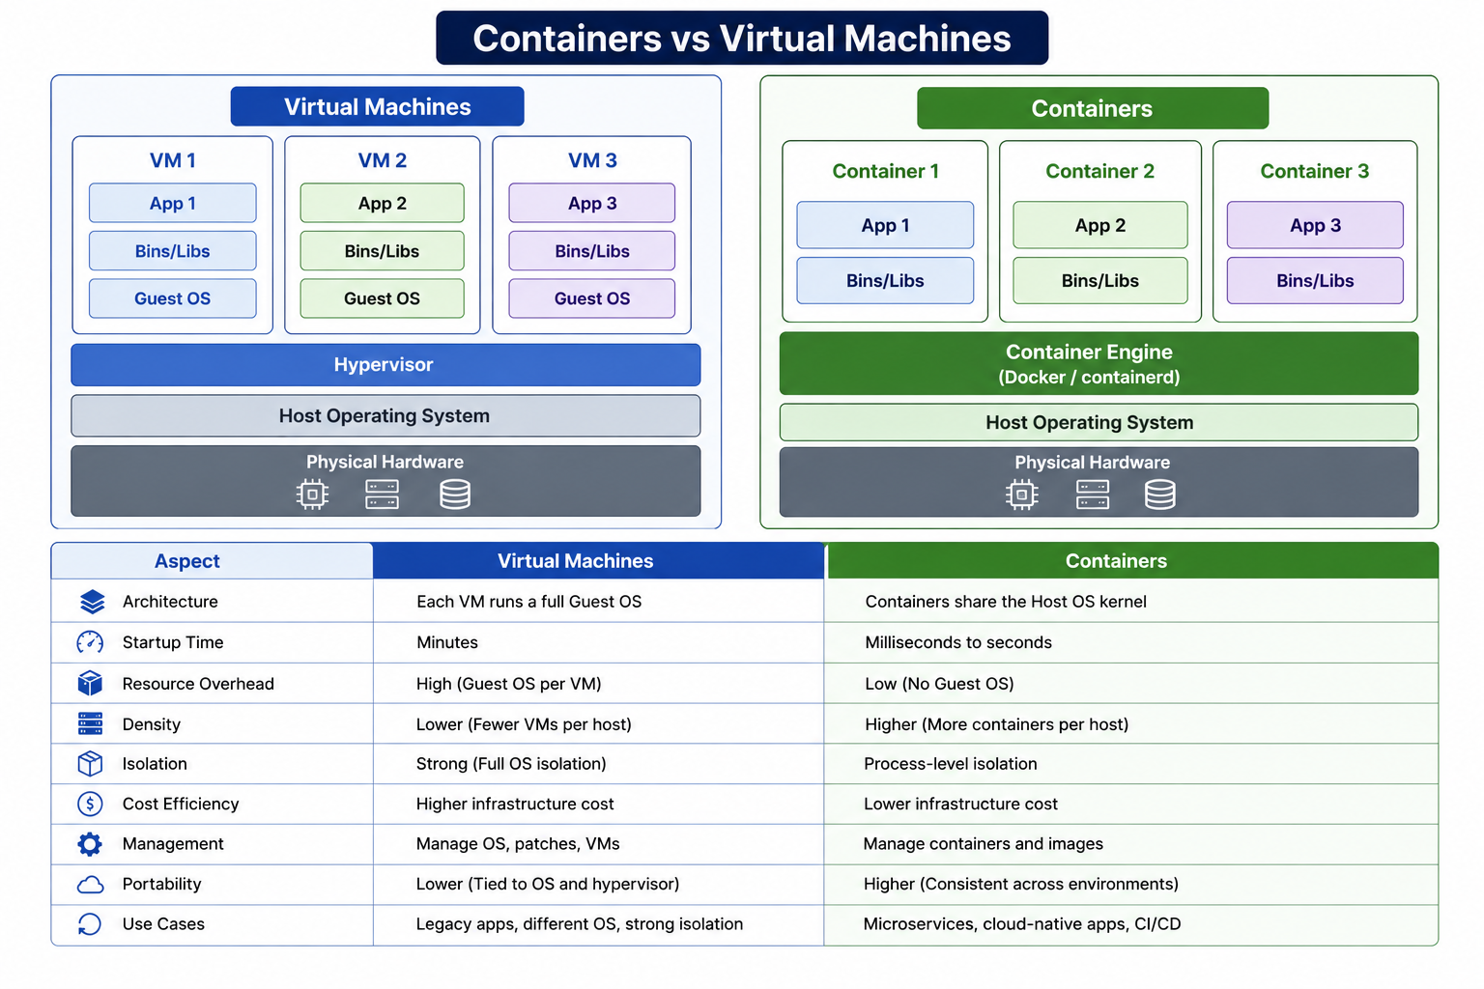
2
© 2026 by Innovation In Software Corporation
Notes:
KEY TALKING POINTS
------------------
- Virtual Machines stack
Each VM carries a whole operating system, so three apps means three kernels to boot, patch, harden, and monitor.
The hypervisor gives strong isolation, because a compromised app must also escape its guest OS and the hypervisor.
That strength is why VMs remain the right choice for mixed operating systems, legacy workloads, and hard tenant boundaries.
It is also why clouds run container platforms on VM nodes rather than directly on shared hardware.
- Containers stack
Removing the guest OS is the whole trick.
Each container is a set of isolated processes sharing the host kernel, with only user-space binaries and libraries in the image.
The engine box says Docker or containerd.
That matches Docker Desktop on the lab VM, while on the ARO cluster the kubelet drives CRI-O.
Because images follow the OCI standard, md287/account-service:1.0.0 built with Docker runs unchanged on CRI-O.
- Comparison table
Read the rows as trade-offs, not a scoreboard.
Startup in milliseconds to seconds refers to the container itself.
A Spring Boot app inside still takes its normal boot time, which is why Lab 4 needs a startup probe.
Process-level isolation is thinner than a VM's, which is why OpenShift adds non-root enforcement and security context constraints.
Lower cost and higher density are general tendencies that depend on workload, not guaranteed savings.
Management shifts from patching servers to rebuilding and rescanning images.
REAL-WORLD EXAMPLES
-------------------
- Regulated workload split: a bank keeps a vendor-supplied core banking package on dedicated virtual machines because the vendor certifies only that setup.
Its own digital channel microservices run as containers on OpenShift, where teams deploy several times a week.
- Test environment density: an enterprise QA group that once needed a VM per service per test environment runs short-lived containerised copies of the full service set for each pull request.
The copies are removed when tests finish, so no idle VMs pile up.
USE-CASE SCENARIO
-----------------
Trace the capstone through both halves of the diagram.
On the lab VM, the Windows host runs Docker Desktop, whose Linux kernel lives in a small WSL2 virtual machine.
Account, Transaction, Postgres, and Kafka containers share that kernel.
On ARO, each worker node is an Azure virtual machine running Red Hat Enterprise Linux CoreOS and CRI-O, and the same Account Service image runs there as a pod.
So the class uses both models at once: VMs for the machine boundary and containers for each service.

Slide 4
LINUX CONTAINER FUNDAMENTALS · IMAGES, CONTAINERS, AND REGISTRIES · CONTAINER IMAGE LAYERS
📌
THE TWO KERNEL FEATURES BEHIND CONTAINERS
📌
THE THREE CONCEPTS
📌
HOW LAYERING WORKS
• Image: a packaged template -- account-service:1.0.0
• Container: a running instance of that image
• Registry: stores and distributes images so platforms like OpenShift can pull them
• Each instruction (FROM, COPY, RUN) creates a new, cacheable image layer
• Unchanged layers are reused across builds, unchanged parts don't need to rebuild
• Poor layer design creates large images or slow, uncacheable builds
• Namespaces: isolate a process's view of PIDs, network, mounts, users, and hostname
• Control groups (cgroups): limit and account for CPU, memory, and I/O usage per process group
• A container runtime (containerd, CRI-O) orchestrates these kernel primitives
KEY TAKEAWAY Under the hood, a container is just a regular Linux process wrapped in kernel namespaces and control groups, not a separate virtualized OS. • account-service:1.0.0 the image becomes a running Account Service process the moment it's started as a container. • Good layer ordering (least-changing instructions first) lets Docker reuse cached layers instead of rebuilding the entire image every time.
3
© 2026 by Innovation In Software Corporation
Notes:
TOPIC 1 OF 3: Linux Container Fundamentals
------------------------------------------
KEY TALKING POINTS
------------------
- THE TWO KERNEL FEATURES BEHIND CONTAINERS
Namespaces control what a process can see.
In its own PID namespace, the Java process can be PID 1.
The network namespace gives it its own interfaces and ports, the mount namespace its own filesystem, and the user and UTS namespaces its own users and hostname.
Control groups control how much it can use.
The 512Mi memory limit in the Lab 4 Deployments is enforced by cgroups, and exceeding it gets the container OOM-killed.
The runtime creates these namespaces and cgroups from the image and settings the platform passes in.
REAL-WORLD EXAMPLES
-------------------
- Noisy neighbour protection: a reporting service with a memory leak shares nodes with a payments API.
Because each pod has a cgroup memory limit, the reporting container is killed and restarted when it hits its limit, and the payments API keeps its memory.
- Port isolation: on a single developer machine, Account Service and a second copy of it can each listen on 8081 inside their own network namespaces.
Only the host port mapping has to differ, which is why Docker Compose publishes ports explicitly.
USE-CASE SCENARIO
-----------------
A participant runs docker run --rm --entrypoint id md287/account-service:1.0.0 in Lab 4 Step 2 and sees uid 100 for user md287, not root.
Inside the container the Java process sees its own process tree and its own /app directory, through namespaces.
On ARO, the Deployment's resources block sets a 256Mi request and a 512Mi limit, enforced by cgroups.
If a bad release leaks memory, only that pod is OOM-killed, and the Transaction Service pods on the same node are unaffected.
TOPIC 2 OF 3: Images, Containers, and Registries
------------------------------------------
KEY TALKING POINTS
------------------
- THE THREE CONCEPTS
An image is read-only, layered, and identified by a name, a tag, and a content digest.
A container adds a thin writable layer plus runtime settings such as environment variables and ports, and it disappears when removed.
The registry is the handoff between build and deploy.
In Lab 4 the image is built locally as md287/account-service:1.0.0, then pushed to the ARO cluster's internal registry with push-images.ps1.
The Deployment is then pointed at the internal pull address with oc set image.
REAL-WORLD EXAMPLES
-------------------
- Approved internal registry: many banks allow production clusters to pull only from an internal registry such as Red Hat Quay.
Images there must pass vulnerability scanning and signing, so an unvetted image from a public registry cannot reach a customer-facing environment.
- One image, many environments: a mortgage application service builds image version 2.3.0 once.
The same digest runs in development, test, and production, with only ConfigMaps and Secrets differing, so the tested artefact is exactly what ships.
USE-CASE SCENARIO
-----------------
Lab 4 Step 7 shows why immutable tags matter.
The team sets INFO_APP_VERSION to 1.0.1 on the Account Service Deployment and confirms /actuator/info reports it.
Then they run oc rollout undo and watch the version return to 1.0.0.
Had everything been tagged latest, nobody could say with certainty which build each pod was running.
With 1.0.0 and 1.0.1 in the registry, the rollback target is explicit and auditable.
TOPIC 3 OF 3: Container Image Layers
------------------------------------
KEY TALKING POINTS
------------------
- HOW LAYERING WORKS
Filesystem-changing instructions such as COPY and RUN each add a layer.
FROM does not add a new layer; it starts from the base image's existing layers.
Metadata instructions such as EXPOSE and USER only record settings.
The builder caches each step and reuses it when the instruction and its inputs are unchanged, but once one step changes, every later step rebuilds.
So put the base image and dependency resolution early and the frequently changing application code late.
Registries also store layers once, so many images sharing a JRE base pull quickly.
REAL-WORLD EXAMPLES
-------------------
- CI pipeline speed: a payments team's pipeline rebuilt its image in several minutes on every commit because it copied all source before downloading Maven dependencies.
Copying pom.xml and resolving dependencies in their own step first let most builds reuse that cached layer.
- Shared base images: an enterprise standardises on one approved Java runtime base image.
Hundreds of service images share those base layers in the registry and on each node, so a new service pull only downloads its small application layers.
USE-CASE SCENARIO
-----------------
In Lab 4 Step 3, participants run docker history md287/account-service:1.0.0.
They see the final image contains the JRE base, the md287 user creation, the copied JAR, the chown, and the EXPOSE and USER entries.
None of the Maven build stage appears.
Ask the room how to speed up rebuilds.
The solution Containerfile copies pom.xml and src and then runs one Maven package step, so any source change repeats the whole Maven build.
Adding a dependency-download step right after copying pom.xml would make that layer reusable.

Slide 5
CONTAINER RUNTIME CONCEPTS · WRITING A DOCKERFILE FOR SPRING BOOT · DOCKERFILE INSTRUCTIONS AND BUILD CONTEXT
📌
RUNTIME CONCEPTS
📌
BASIC SPRING BOOT DOCKERFILE
• Container runtime: the software that creates and manages the container lifecycle on a node
• CRI (Container Runtime Interface): the standard API Kubernetes uses to talk to any compliant runtime
• OpenShift uses CRI-O by default -- a lightweight, Kubernetes-native runtime
• FROM eclipse-temurin:17-jre WORKDIR /app
• COPY target/account-service.jar app.jar EXPOSE 8080
• ENTRYPOINT ["java", "-jar", "app.jar"]
📌
COMMON DOCKERFILE INSTRUCTIONS
✅
BUILD CONTEXT DISCIPLINE
• FROM, WORKDIR, COPY, RUN, ENV, EXPOSE, USER, ENTRYPOINT, CMD
• The build context is the file set sent to the image builder
• Use .dockerignore to exclude .git, .idea, *.log, and other unneeded files
KEY TAKEAWAY containerd and CRI-O implement the Container Runtime Interface that Kubernetes and OpenShift use to run pods on every node. • FROM eclipse-temurin:17-jre, COPY the JAR, EXPOSE 8080, ENTRYPOINT java -jar app.jar -- the minimum viable Spring Boot Dockerfile. • Without a .dockerignore, .git folders, local credentials, and IDE metadata can silently end up inside the build context and even the image.
4
© 2026 by Innovation In Software Corporation
Notes:
TOPIC 1 OF 3: Container Runtime Concepts
----------------------------------------
KEY TALKING POINTS
------------------
- RUNTIME CONCEPTS
On every OpenShift node, the kubelet receives the pod spec and calls the runtime through CRI to pull images, create containers, and report status.
CRI-O is purpose-built for Kubernetes and does nothing else, which keeps the node footprint small.
On the lab VM, Docker Desktop uses its own engine, with containerd underneath.
Podman, which the course stack mentions, is a daemonless alternative.
All of them follow the OCI image and runtime specifications, which is why an image built with Docker on the VM runs under CRI-O on ARO.
REAL-WORLD EXAMPLES
-------------------
- Kubernetes removed its built-in Docker Engine integration, dockershim, in version 1.24.
Clusters moved to CRI runtimes such as containerd and CRI-O, and images built with Docker kept working because they follow the OCI standard.
- Enterprise build machines: some banks restrict long-running root daemons on build agents, so pipelines use daemonless builders such as Podman or Buildah.
The resulting OCI images deploy to the same OpenShift clusters without changes.
USE-CASE SCENARIO
-----------------
A participant asks why Lab 4 builds with docker build when OpenShift does not run Docker.
Walk the chain.
Docker Desktop on the VM builds md287/transaction-service:1.0.0 as an OCI image, and push-images.ps1 sends its layers to the ARO internal registry.
After oc set image, the kubelet on a worker node asks CRI-O to pull those same layers and start the container with the probes, limits, and security context from 20-transaction.yaml.
Nothing about the image changed in between.
TOPIC 2 OF 3: Writing a Dockerfile for Spring Boot
------------------------------------------
KEY TALKING POINTS
------------------
- BASIC SPRING BOOT DOCKERFILE
Each line has one job.
FROM picks a Java runtime, not a full JDK.
WORKDIR sets the directory, COPY brings in a JAR that Maven built earlier, and ENTRYPOINT starts it in exec form so the JVM receives stop signals directly.
EXPOSE only documents the port; the actual port comes from Spring configuration.
Contrast with Lab 4's Containerfile.
It is a multi-stage build on Java 21: a Maven builder stage, then an eclipse-temurin:21-jre-alpine runtime.
It adds a non-root md287 user with USER md287 and exposes 8081 for Account and 8082 for Transaction.
REAL-WORLD EXAMPLES
-------------------
- Signal handling: a bank's settlement service used a shell-form entrypoint, so the JVM never received the termination signal during rolling deployments and was force-killed mid-batch.
Switching to exec-form ENTRYPOINT let Spring Boot shut down gracefully and finish in-flight work.
- Root user rejection: teams moving images from a developer laptop to OpenShift often find containers that ran as root locally are refused, or fail on file permissions, under OpenShift's restricted security defaults.
Adding a dedicated non-root user in the image avoids that surprise.
USE-CASE SCENARIO
-----------------
Put the slide's example next to labs/day-04/lab4/solution/account-service/Containerfile.
Ask the room to list the differences.
Java 17 versus 21.
A single stage that expects a pre-built JAR versus a Maven builder stage.
Port 8080 versus 8081.
Root versus user md287.
Then connect to the cluster: on ARO, the Deployment adds runAsNonRoot true and runAsUser 100, because OpenShift cannot confirm that a named user is non-root.
Without that, the pod fails with CreateContainerConfigError, as listed in the Lab 4 troubleshooting table.
TOPIC 3 OF 3: Dockerfile Instructions and Build Context
------------------------------------------
KEY TALKING POINTS
------------------
- COMMON DOCKERFILE INSTRUCTIONS
FROM sets the base.
WORKDIR sets the working directory.
COPY brings files in from the context, and RUN executes build commands such as creating a user or running Maven.
ENV sets environment defaults, which is fine for non-sensitive values but never for passwords, because they stay visible in image metadata.
EXPOSE documents a port.
USER switches away from root for everything after it, including runtime.
ENTRYPOINT defines the fixed command, and CMD supplies default arguments that can be overridden at run time, so the two are often used together.
- BUILD CONTEXT DISCIPLINE
The build sends the whole context directory to the builder before any instruction runs.
A careless COPY of the whole folder can then copy Git history, IDE settings, local logs, or credential files into a layer.
A .dockerignore at the context root keeps them out and makes builds faster.
In Lab 4, the context is the Lab 3 solution module and the Containerfile is passed with -f from the Lab 4 folder.
Step 1 asks you to confirm each Lab 3 module has a .dockerignore excluding target, tests, and IDE files.
REAL-WORLD EXAMPLES
-------------------
- Leaked credentials: security teams regularly find cloud keys or database passwords in public images because a developer's local configuration file sat in the build context and a broad COPY instruction included it.
Deleting the file in a later layer does not remove it from the earlier layer.
- Slow uploads: a team's build context included several gigabytes of old target directories and test data.
Every build spent most of its time just sending files to the builder, until a .dockerignore cut the context down to the source and build file.
USE-CASE SCENARIO
-----------------
A participant's Lab 4 build fails with a COPY error saying pom.xml cannot be found.
They ran docker build from the Lab 4 starter folder with a dot as the context, so the builder never received the Lab 3 source.
The Lab 4 troubleshooting table gives the fix: the context must be the Lab 3 solution module, with -f pointing at the Lab 4 Containerfile.
With the right context, that module's .dockerignore also applies, so stale target folders and IDE files stay out of the upload.

Slide 6
MULTI-STAGE CONTAINER BUILDS · LAYERED SPRING BOOT IMAGES
📌
MULTI-STAGE CONCEPT
📌
WHY LAYERED JARS HELP
• FROM maven:3.9-eclipse-temurin-17 AS build -> mvn clean package
• FROM eclipse-temurin:17-jre -> COPY --from=build ... app.jar
• The final image contains only the runtime and the compiled JAR, nothing from the build stage
• spring-boot:build-image or layertools extracts dependencies, resources, and application classes into separate layers
• Dependencies rarely change -- that layer stays cached across most builds
• Only the application-classes layer typically needs to be rebuilt and re-pushed
KEY TAKEAWAY The Maven build tools, source code, and intermediate files never make it into the final image -- only the compiled JAR does. • Since dependencies change far less often than your own code, layering means most rebuilds only need to push one small, changed layer.
5
© 2026 by Innovation In Software Corporation
Notes:
TOPIC 1 OF 2: Multi-Stage Container Builds
------------------------------------------
KEY TALKING POINTS
------------------
- MULTI-STAGE CONCEPT
Each FROM starts a new stage with a clean filesystem.
The build stage has everything needed to compile.
The final stage starts from a runtime-only image and copies in a single artifact, and only that last stage becomes the shipped image.
The slide shows Java 17 tags.
The Lab 4 Containerfile follows the same pattern on Java 21: maven:3.9.9-eclipse-temurin-21-alpine AS build runs mvn -q -DskipTests package, then eclipse-temurin:21-jre-alpine copies /src/target/*.jar to app.jar.
The results are a smaller image, fewer packages for scanners to flag, no source code in production, and a build that needs no local Maven install.
REAL-WORLD EXAMPLES
-------------------
- A card-authorisation team that ships a full JDK, Maven, and a populated .m2 cache in its production images gives vulnerability scanners many extra packages to flag, and gives an attacker a compiler inside the container.
A multi-stage build removes those findings at the source instead of suppressing them one by one.
- Enterprise CI runners often differ from developer laptops in Maven version and JDK patch level.
Running mvn package inside the build stage pins the toolchain in the Containerfile, so a statement-generation service compiles the same way on a laptop, in a Tekton task, or on a colleague's VM.
USE-CASE SCENARIO
-----------------
In Lab 4 Step 2, participants build md287/account-service:1.0.0.
The build context is the Lab 3 solution module and -f points at the Lab 4 Containerfile.
The first build downloads Maven plugins inside Docker and takes several minutes.
In Step 3 they run docker history md287/account-service:1.0.0 and confirm that no Maven layers remain: only the Alpine JRE, the copied JAR, the user setup, EXPOSE, and USER.
Picture a security reviewer on the capstone asking whether Transaction Service source code or build tools could leak into production.
Instead of reassurance, the team shows the docker history output as evidence that only the runtime and the JAR ship.
TOPIC 2 OF 2: Layered Spring Boot Images
----------------------------------------
KEY TALKING POINTS
------------------
- WHY LAYERED JARS HELP
Spring Boot's default layer index has four layers, in this order: dependencies, spring-boot-loader, snapshot-dependencies, and application.
By default, resources such as application.yml ship inside the application layer.
Once one layer changes, every layer after it is rebuilt, so the least-changed content goes first.
Buildpacks do this automatically.
With a Containerfile, Spring Boot 3.3 and later extracts layers with java -Djarmode=tools -jar app.jar extract --layers --launcher, which replaces the older layertools mode, and each layer directory gets its own COPY.
Registries skip layers they already hold, so a push uploads only what changed.
Be candid that the Lab 4 Containerfile copies the whole JAR as a single layer.
REAL-WORLD EXAMPLES
-------------------
- A fraud-rules service is redeployed several times a day.
The rule logic changes, but the Spring, Kafka client, and PostgreSQL driver versions do not.
With a layered image, docker push reports that most layers already exist and uploads only the application layer, and nodes that ran the previous version reuse the cached dependency layers.
- Registries and container hosts deduplicate by layer digest.
When an Account Service image and a Transaction Service image share the same JRE base, the registry stores those base layers once, and each OpenShift node pulls them once, however many services use them.
USE-CASE SCENARIO
-----------------
Suppose a capstone team fixes a validation bug in Transaction Service on the afternoon of a busy release.
With the current Lab 4 Containerfile, the whole fat JAR is one layer, so the push through the classroom registry Route re-uploads the entire JAR even though only a few classes changed.
If the team adds a build step that extracts the layers and copies dependencies, spring-boot-loader, snapshot-dependencies, and application separately, the same fix re-pushes only the application layer.
The optional Lab 4 stretch asks participants to compare docker history for Transaction and Account Service.
That is a natural moment to sketch the layered version on the whiteboard.

Slide 7
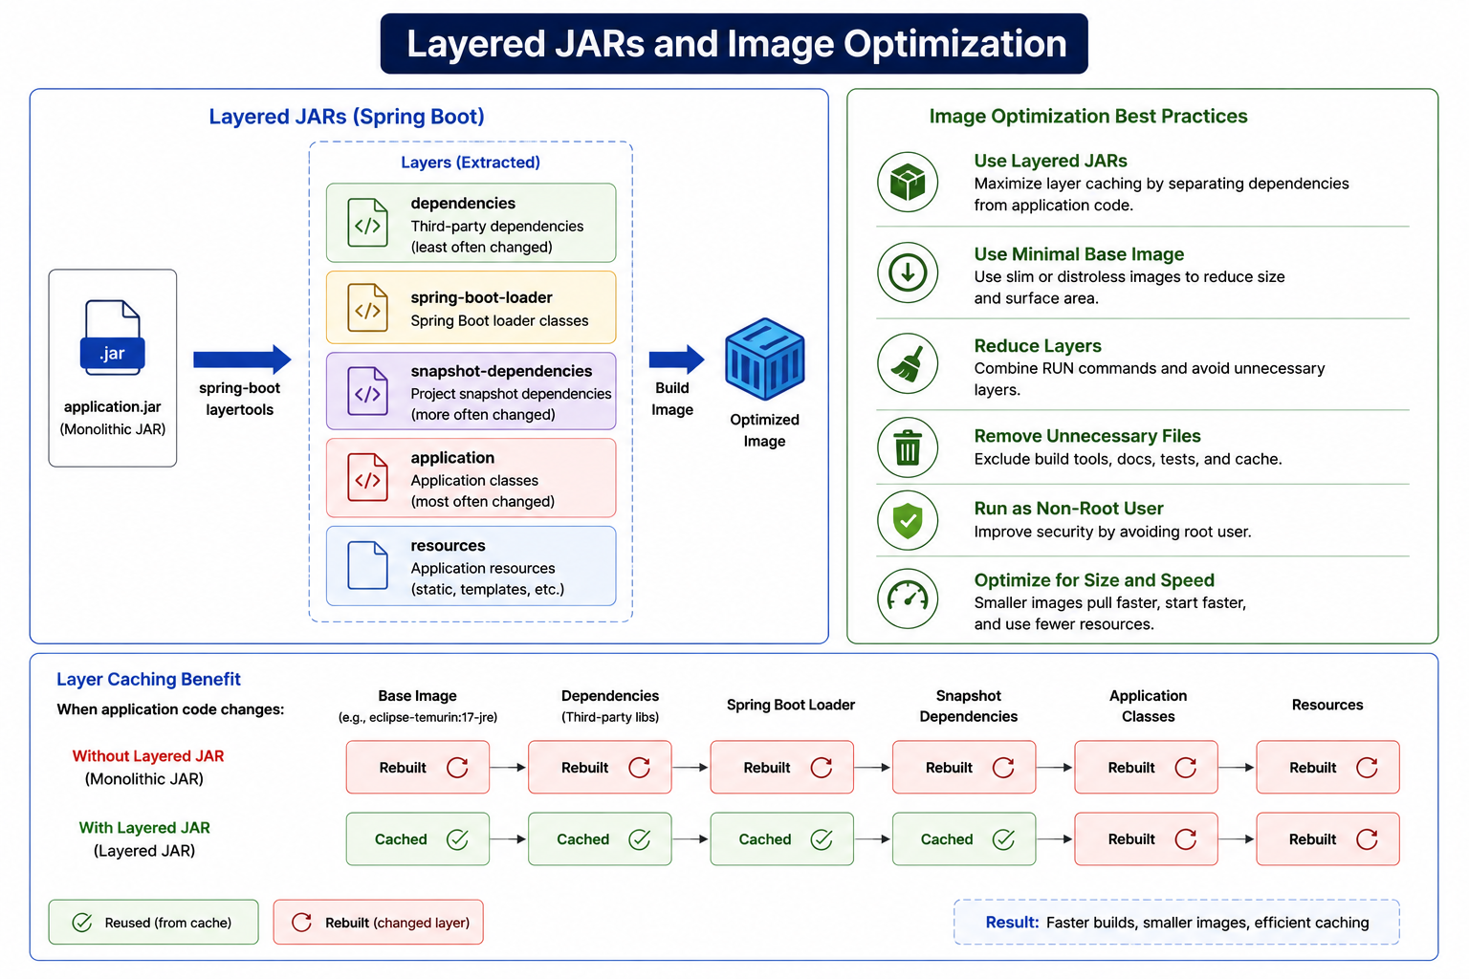
6
© 2026 by Innovation In Software Corporation
Notes:
KEY TALKING POINTS
------------------
- Layered JARs (Spring Boot)
The flow is correct in spirit: extract the fat JAR into layers, then copy each layer into the image separately.
Two corrections are worth making.
Spring Boot's default is four layers, in this order: dependencies, spring-boot-loader, snapshot-dependencies, application.
The separate resources box is not a default layer, because resources ship inside application unless you customize the layer configuration.
Also, layertools is the older tool: Spring Boot 3.3 and later uses the tools jar mode with extract --layers.
Order matters because a change in one layer forces a rebuild of every layer after it.
- Image Optimization Best Practices
Tie each row to Lab 4.
Layered JARs are the optimization we have not yet added.
For the minimal base image, the lab uses eclipse-temurin:21-jre-alpine.
Distroless images go further but have no shell for debugging.
Reduce layers by combining related RUN commands.
Remove unnecessary files with the .dockerignore that already exists in each Lab 3 solution module.
Run as a non-root user with USER md287 in the lab Containerfile.
Size and speed matter on OpenShift because a node pulling an image for the first time waits for every missing layer before the pod can start.
- Layer Caching Benefit
The two rows make the argument, but the red row overstates it.
A plain fat-JAR build does not rebuild or re-pull the base image when code changes, because the eclipse-temurin layers stay cached either way.
The real difference is that the fat JAR sits in one COPY layer that changes on every code edit, so the whole JAR is rebuilt and re-pushed.
With extracted layers, dependencies, the loader, and snapshot dependencies stay cached.
The green row's rebuilt Resources cell only applies when resources actually changed.
REAL-WORLD EXAMPLES
-------------------
- In a bank where automated dependency-update pull requests land regularly, the dependencies layer does change on those days and the large layer is re-pushed.
On ordinary feature days only the application layer moves, which is why layering helps most for services that are released often.
- OpenShift nodes run the CRI-O container runtime, which pulls only the image layers a node does not already have.
A new Account Service replica scheduled on a node that ran the previous version starts sooner because the shared layers are already local.
USE-CASE SCENARIO
-----------------
Run docker history md287/account-service:1.0.0 on the instructor VM and show the single large layer created by the COPY of app.jar.
Then ask the room how the Containerfile would change to extract layers: a step that runs the tools jar mode in the build stage, then four COPY --from=build lines in dependency-first order.
Tell the story of a capstone hotfix to Transaction Service on payroll day.
The operations team wants the fix rolled out quickly across replicas, and the layered image means each node pulls only the changed application layer before readiness passes.

Slide 8
BUILDPACKS AND CLOUD-NATIVE BUILDPACKS · CONTAINER IMAGE TAGGING STRATEGIES · CONTAINER REGISTRIES
📌
WHY BUILDPACKS HELP
📌
GOOD TAGGING EXAMPLES
• Automatically detect the language/framework and apply best-practice image construction
• No Dockerfile to write or maintain; consistent, reproducible builds across teams
• mvn spring-boot:build-image is the common Spring Boot entry point
• Semantic version: 1.4.2
• Git commit SHA: a1b2c3d
• Build number: build-105
• Avoid relying only on mutable tags like latest for traceable deployments
📌
COMMON REGISTRIES
✅
REGISTRY SECURITY
• Red Hat Quay, OpenShift internal registry, Docker Hub, GitHub Container Registry, cloud provider registries
• Authentication, authorization, image scanning, audit logging, image signing
• Image pull secrets give OpenShift credentials to pull from authenticated registries
KEY TAKEAWAY spring-boot:build-image uses Paketo buildpacks under the hood, automatically detecting Java and producing a production-ready, layered image. • Semantic versions, Git commit SHAs, and build numbers all answer 'what exactly is deployed?' -- latest never does. • Authentication, image scanning, and image pull secrets turn a registry from a simple file store into an enterprise-grade delivery gate.
7
© 2026 by Innovation In Software Corporation
Notes:
TOPIC 1 OF 3: Buildpacks and Cloud-Native Buildpacks
------------------------------------------
KEY TALKING POINTS
------------------
- WHY BUILDPACKS HELP
Cloud Native Buildpacks is a CNCF specification, and Paketo provides the Java implementation.
spring-boot:build-image asks the local Docker daemon to run a Paketo builder.
The builder detects the Maven project, adds a JRE, applies Spring Boot layering, configures a JVM memory calculator, and produces an image that runs as a non-root user.
Teams stop copying slightly different Dockerfiles around, and the platform team can update the builder centrally.
Trade-offs: less fine-grained control, and builder images come from outside unless mirrored.
Bank policy may require approved base images.
Lab 4 uses explicit Containerfiles so every instruction stays visible.
OpenShift's own Source-to-Image builds are a similar idea.
REAL-WORLD EXAMPLES
-------------------
- A platform team supporting dozens of Spring Boot services publishes one approved builder.
When a JRE security patch is released, the team updates the builder, and pack rebase can swap the patched base layers under existing application layers without recompiling each service.
- In organizations where every squad writes its own Dockerfile, drift is common: different base images, some running as root, some missing a .dockerignore.
Standardizing on buildpacks removes that drift, because every loan, payments, and statements service gets the same image structure.
USE-CASE SCENARIO
-----------------
Imagine the capstone team preparing Risk Assessment Service for Day 5 and debating whether to write a third Containerfile or use buildpacks.
As an optional exploration, a participant could run mvn spring-boot:build-image in the Lab 3 Account Service solution on the course VM, because Docker Desktop is available.
They then compare docker history and the runtime user with the md287/account-service:1.0.0 image built from the Lab 4 Containerfile.
The discussion lands on policy.
The buildpack route needs the builder image pulled from outside the bank unless it is mirrored, while the Containerfile route makes it easy to prove the approved base image.
Keep this as discussion; it is not a lab step.
TOPIC 2 OF 3: Container Image Tagging Strategies
------------------------------------------
KEY TALKING POINTS
------------------
- GOOD TAGGING EXAMPLES
Semantic versions are for humans, release notes, and change tickets.
A Git commit SHA ties an image to the exact source revision that produced it.
A build number ties it to the pipeline run that holds the test report, scan result, and SBOM.
Mature teams often combine them, for example a version tag plus an OCI revision label holding the commit SHA.
latest is a moving pointer, and it is the default when no tag is given, so two deploys a day apart can run different code under the same name.
Lab 4 uses 1.0.0 and 1.0.1, never latest.
REAL-WORLD EXAMPLES
-------------------
- During a payments incident, the on-call engineer runs oc get deploy -o wide to see which images are running.
If the answer is transaction-service:latest, nobody can say which commit is live.
If it is 1.4.2 or a commit SHA, the engineer can open the matching release notes and diff within minutes.
- In bank change management, the approved change ticket records the exact image version that passed testing.
A production deploy of a tag like latest cannot be matched to that approval, so auditors treat it as an unapproved change.
USE-CASE SCENARIO
-----------------
In Lab 4, participants tag local images md287/account-service:1.0.0 and md287/transaction-service:1.0.0.
push-images.ps1 retags them as registry-host/project/account-service:1.0.0 and pushes them.
Deployments then point at the internal pullspec with the same 1.0.0 tag.
In Step 7 they roll forward to version 1.0.1 and back with oc rollout undo, and /actuator/info shows which version answers.
Tell the story of a teammate asking which Account Service build passed the Step 6 scan gate: because the tag is 1.0.0 rather than latest, the scan report, SBOM, and running pods can all be matched.
TOPIC 3 OF 3: Container Registries
----------------------------------
KEY TALKING POINTS
------------------
- COMMON REGISTRIES
Red Hat Quay is Red Hat's enterprise registry, with built-in vulnerability scanning.
The OpenShift internal registry runs inside the cluster and stores images per project, and it is what Lab 4 uses.
Docker Hub is the public default and limits anonymous pulls, which is why banks mirror base images internally.
GitHub Container Registry suits teams already on GitHub.
Cloud registries include Azure Container Registry, the natural fit next to Azure Red Hat OpenShift.
The classroom cluster has two registry names: an external Route, default-route-openshift-image-registry.apps.aro-md287.centralus.aroapp.io, for pushes from the VM, and the in-cluster service image-registry.openshift-image-registry.svc:5000 for pulls.
- REGISTRY SECURITY
Authentication proves who is pushing: push-images.ps1 runs docker login with your oc whoami user and oc whoami -t token.
Authorization limits where you can push: participants have edit on their own md287 project only.
Scanning finds known CVEs, audit logs record who pushed what, and signing, for example with Cosign as in Lab 4 Step 6, proves an image came from the trusted pipeline.
Pull secrets are dockerconfigjson Secrets linked to a service account, needed when the cluster pulls from a registry that requires credentials.
Lab 4 pods need none, because service accounts can already pull from their own project's internal registry.
REAL-WORLD EXAMPLES
-------------------
- Regulated enterprises commonly restrict clusters to an approved list of registries.
OpenShift supports this through the cluster image configuration's allowed registries setting, so an engineer cannot accidentally deploy an unvetted image from a public registry into a production banking project.
- When Docker Hub introduced pull rate limits for anonymous and free users, many CI pipelines that pulled base images on every build began failing intermittently.
Enterprises responded by mirroring approved base images into internal Quay, Artifactory, or cloud registries.
USE-CASE SCENARIO
-----------------
Walk through Lab 4 Step 5 from the registry's point of view.
The participant has already run oc login.
They set MD287_REGISTRY to the default-route hostname, because edit rights on their own project do not let them read the Route object in the openshift-image-registry namespace.
push-images.ps1 logs in with their token, tags both capstone images under their project, and pushes them.
They then run oc set image so the Deployments pull from image-registry.openshift-image-registry.svc:5000 inside the cluster.
If a pod shows ImagePullBackOff, the troubleshooting table says to re-run the push script and check the pullspec.

Slide 9
IMAGE IMMUTABILITY · CONTAINER CONFIGURATION AND ENVIRONMENT VARIABLES · CONTAINER NETWORKING
📌
WHY IMMUTABILITY MATTERS
📌
ENVIRONMENT VARIABLES IN PRACTICE
📌
PORT MAPPING EXAMPLE
• An image tag that can be overwritten breaks the guarantee that a deployment is reproducible
• Immutable, versioned tags (1.0.0, 1.0.1) make rollbacks and audits reliable
• Pin to a specific digest or version tag in production, never a mutable one
• Spring Boot listens on port 8080 inside the container
• docker run -p 8081:8080 account-service:1.0.0 maps that to host port 8081
• The service becomes reachable locally at http://localhost:8081
• docker run -e SPRING_PROFILES_ACTIVE=prod account-service:1.0.0
• Supports the build-once, configure-per-environment model
• Spring Boot reads environment variables directly into its configuration properties
KEY TAKEAWAY Immutable, versioned tags guarantee that the same tag always deploys the exact same bits, in every environment, every time. • docker run -e SPRING_PROFILES_ACTIVE=prod passes configuration in without ever touching or rebuilding the image. • docker run -p 8081:8080 exposes a service listening on container port 8080 to the outside world on host port 8081.
8
© 2026 by Innovation In Software Corporation
Notes:
TOPIC 1 OF 3: Image Immutability
--------------------------------
KEY TALKING POINTS
------------------
- WHY IMMUTABILITY MATTERS
A tag is a pointer, and a digest such as sha256:...
identifies the content itself.
If someone re-pushes a changed build as account-service:1.0.0, two replicas can silently run different code.
Lab manifests use imagePullPolicy IfNotPresent, so a node with the old 1.0.0 cached keeps the old bits while a fresh node pulls the new ones.
Rollback suffers too: oc rollout undo restores the previous pod template, which names a tag, so an overwritten tag brings back the wrong image.
Enforce immutability with registry features, such as tag immutability rules in Harbor or Amazon ECR, or by deploying the digest itself.
REAL-WORLD EXAMPLES
-------------------
- Picture a statement-generation team that pushes a hotfix by overwriting its existing 2.3.0 tag.
When the fix misbehaves at month end and they run a rollback, the platform redeploys 2.3.0, which is now the broken hotfix, and the incident gets longer instead of shorter.
- When an examiner asks a bank to prove that production ran exactly the artifact that passed scanning, the team compares the digest recorded in the pipeline with the imageID reported in each running pod's container status.
That comparison only works if deployments reference immutable content.
USE-CASE SCENARIO
-----------------
In Lab 4 Step 7, participants roll Account Service forward to 1.0.1, confirm the change through /actuator/info on the Route, then run oc rollout undo and check that oc rollout history shows more than one revision.
The undo can be trusted because nobody re-pushed 1.0.0.
Ask the room to imagine that a teammate rebuilt Account Service with an experimental change and pushed it as 1.0.0 before the undo.
The rollback would report success while pods on different nodes might run two different builds, and the scan evidence from Step 6 would no longer describe what is live.
TOPIC 2 OF 3: Container Configuration and Environment Variables
------------------------------------------
KEY TALKING POINTS
------------------
- ENVIRONMENT VARIABLES IN PRACTICE
The -e flag sets a variable when the container starts.
Spring Boot's relaxed binding maps SPRING_DATASOURCE_URL to spring.datasource.url, and environment variables override the application.yml packaged in the JAR.
In Lab 4 the same image gets SPRING_PROFILES_ACTIVE=openshift from the Deployment.
The ConfigMaps supply SERVER_PORT, SPRING_DATASOURCE_URL, SPRING_KAFKA_BOOTSTRAP_SERVERS, and MD287_ACCOUNT_SERVICE_BASE_URL.
The Secret md287-db-secrets supplies the database password and MD287_JWT_SECRET through secretKeyRef.
One caution: values passed with docker run -e appear in plain text in docker inspect, so real secrets need a proper secret store.
REAL-WORLD EXAMPLES
-------------------
- A payments image is promoted from development to test to production as the same digest.
Only the injected configuration differs: database URL, Kafka bootstrap servers, log level, and feature flags.
The change board approves one artifact rather than three environment-specific builds.
- The Twelve-Factor App methodology, written by engineers at Heroku, lists storing config in the environment as factor three.
That principle is why Spring Boot, OpenShift ConfigMaps, and container runtimes all treat environment variables as the standard way to inject configuration.
USE-CASE SCENARIO
-----------------
Show the capstone promotion path.
On the VM, Docker Compose starts md287/account-service:1.0.0 with environment values pointing at the Compose Postgres container.
On ARO, the same image runs with the account-config ConfigMap pointing at jdbc:postgresql://account-db:5432/account_db and the Secret providing credentials.
Nothing is rebuilt.
In Step 7, oc set env deploy/account-service INFO_APP_VERSION=1.0.1 changes only an environment variable, and OpenShift treats it as a new rollout revision that oc rollout undo can reverse.
That demonstrates configuration changes are versioned deploy events too.
TOPIC 3 OF 3: Container Networking
----------------------------------
KEY TALKING POINTS
------------------
- PORT MAPPING EXAMPLE
The -p flag reads host-port:container-port.
EXPOSE in a Containerfile only documents a port and publishes nothing.
Spring Boot defaults to 8080, but the capstone differs from the slide: Account Service listens on 8081 inside the container, via EXPOSE 8081 and SERVER_PORT 8081, and Compose maps 8081:8081.
Transaction Service uses 8082:8082.
Running the lab image with -p 8081:8080 would connect to nothing.
By default -p binds all host interfaces; 127.0.0.1:8081:8081 keeps it local.
On OpenShift there are no host ports: a Service forwards port 8081 to the pod's container port, and a Route exposes that Service.
REAL-WORLD EXAMPLES
-------------------
- A developer runs two vendor containers that both listen on 8080 internally.
Mapping one to host port 8081 and the other to 8082 lets both run side by side, which is exactly why host and container ports are separate numbers.
- On a shared jump host, publishing a test container with -p 8081:8081 binds every network interface, so a colleague on the same subnet can reach an instance loaded with synthetic customer data.
Publishing on 127.0.0.1 keeps it private to that machine.
USE-CASE SCENARIO
-----------------
A participant starts Lab 4 Compose and gets a port-already-allocated error on 8081.
The Lab 4 troubleshooting table explains why: a Lab 1 to Lab 3 stack still holds the same host ports.
They run docker ps, find the old Account Service container, run docker compose down in that lab folder, and try again.
Inside the Compose network, Transaction Service reaches Account Service by service name, not through the host mapping.
On ARO, the transaction-config ConfigMap sets MD287_ACCOUNT_SERVICE_BASE_URL to http://account-service:8081, the in-cluster Service name, not the public Route.

Slide 10
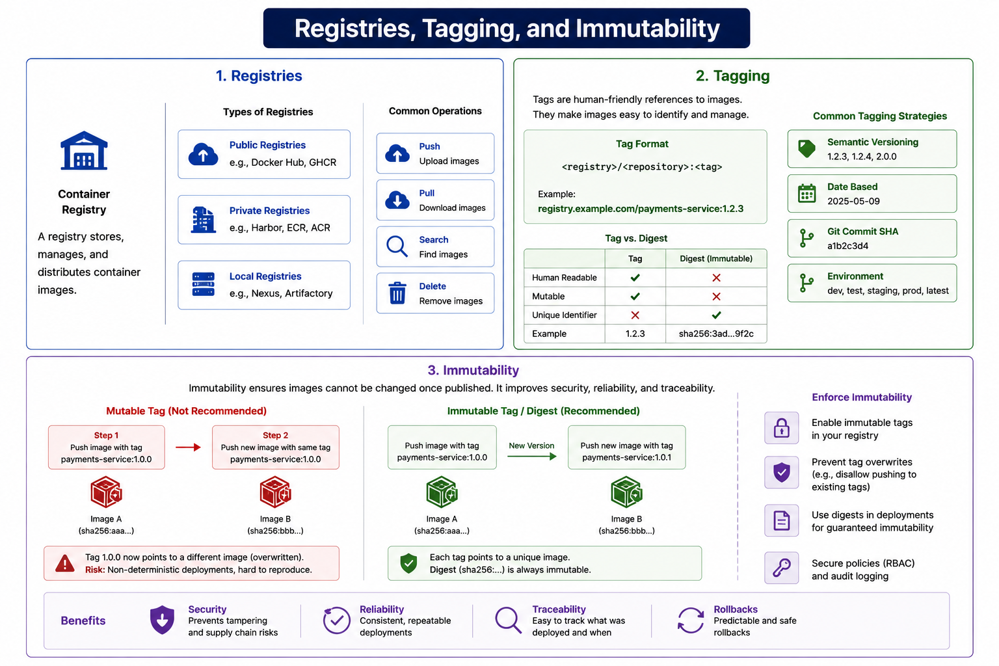
9
© 2026 by Innovation In Software Corporation
Notes:
KEY TALKING POINTS
------------------
- 1. Registries
The definition is right: a registry stores, manages, and distributes images.
Map the types to our world.
The public examples are Docker Hub and GHCR.
The private examples, Harbor, ECR, and ACR, are the kind a bank uses.
Nexus and Artifactory, labeled local, are really self-hosted private registries, often used as mirrors.
The diagram omits the two registries this course relies on: Red Hat Quay and the OpenShift internal registry that Lab 4 pushes to.
Push and pull are the everyday operations, while delete in a bank is governed by retention policy, because audits may need old images.
- 2. Tagging
The tag format box simplifies the name.
Real names usually have a namespace, as in Lab 4: registry host, then md287 project, then account-service, then 1.0.0.
The tag versus digest table is the key teaching point: tags are readable and mutable, while digests are unique and immutable.
Semantic versioning, date-based tags, and Git commit SHAs are sound strategies.
Treat the Environment row with care.
Tags such as prod or latest are, by design, moved from image to image, which contradicts the immutability panel below, so they can be convenience pointers but never the reference a Deployment uses.
- 3. Immutability
The red path shows payments-service:1.0.0 pushed twice, so the same tag points first to Image A and then to Image B, which makes deployments non-deterministic.
The green path pushes 1.0.1 for the new build, so each tag keeps its image, and the digest never changes.
The Enforce Immutability column lists the controls: registry immutable-tag settings, blocking overwrites, deploying by digest, and RBAC with audit logging.
In Lab 4 the protection is discipline plus RBAC: only your pipeline or your own account can push to your project, and versions move from 1.0.0 to 1.0.1.
- Benefits
Each benefit ties to a Day 4 activity.
Security means a verified, signed image cannot be quietly swapped, which is Step 6's Cosign verification.
Reliability means every replica runs identical bits.
Traceability means that a tag and digest link a running pod to its commit, scan, and SBOM.
Rollbacks means that oc rollout undo in Step 7 returns to a known-good image, because 1.0.0 still means what it meant yesterday.
REAL-WORLD EXAMPLES
-------------------
- Amazon ECR offers a per-repository tag immutability setting, and Harbor supports tag immutability rules.
Banks often enable these on release repositories so that no one, including pipeline service accounts, can overwrite a published version.
- Teams practicing GitOps commonly record the image digest in the deployment manifest stored in Git.
The Git history then becomes an audit trail of exactly which content ran in production and when it changed, which regulators and internal audit find easy to review.
USE-CASE SCENARIO
-----------------
Tell the story using the capstone names.
A participant finishes Lab 4 Step 5 with account-service:1.0.0 running on ARO.
The next morning they rebuild with a small logging change and, in a hurry, push it as 1.0.0 again.
One pod restarts on a node that pulls the new bits, while the other node still has the old image cached because of IfNotPresent.
Debugging now produces confusing, inconsistent logs.
Replay it the green-path way: push 1.0.1, run oc set image, watch the rollout, and keep oc rollout undo as a clean escape to the untouched 1.0.0.

Slide 11
CONTAINER STORAGE · CONTAINER RESOURCE LIMITS · RUNNING AS A NON-ROOT USER
📌
EPHEMERAL VS. PERSISTENT STORAGE
📌
WHY RESOURCE LIMITS MATTER
📌
WHY NON-ROOT MATTERS
• Container filesystem: temporary, lost when the container is removed or replaced
• Volumes: external storage mounted into the container, surviving restarts and replacements
• Stateless microservices should avoid depending on local container storage entirely
• Without limits, one runaway container can exhaust node CPU or memory
• Requests reserve a guaranteed minimum; limits cap the maximum
• Both should be set deliberately based on real observed workload
• Containers should avoid running as root unless explicitly required
• OpenShift enforces security constraints expecting restricted, non-root permissions
• Test images locally as non-root before assuming they'll work on the platform
KEY TAKEAWAY Anything written inside a container's own filesystem disappears when it's replaced; only mounted volumes persist across restarts. • CPU and memory requests and limits protect both the container's own stability and the shared cluster it runs on. • A USER instruction in the Dockerfile, matched to OpenShift's security context constraints, avoids surprise permission failures at deploy time.
10
© 2026 by Innovation In Software Corporation
Notes:
TOPIC 1 OF 3: Container Storage
-------------------------------
KEY TALKING POINTS
------------------
- EPHEMERAL VS. PERSISTENT STORAGE
Each container gets a thin writable layer over its read-only image layers.
With plain Docker that layer survives a stop and start of the same container but is deleted with docker rm or a Compose recreate.
On OpenShift it is stricter: when a container restarts inside a pod, for example after a failed liveness probe, it starts with a fresh filesystem.
An emptyDir volume survives container restarts but not pod deletion.
A PersistentVolumeClaim survives pod replacement.
Capstone services keep no local state: accounts live in account-db, transactions in transaction-db, and events in Kafka.
The Lab 4 manifests declare no volumes at all.
REAL-WORLD EXAMPLES
-------------------
- Imagine a statement service that writes generated PDF statements to a local directory and serves download links from there.
After the next rolling update, the new pods have empty filesystems, customers get missing-file errors, and the fix is to move the files to object storage or a persistent volume.
- A team runs PostgreSQL in a container during testing without mounting a volume.
When the container is recreated for an image update, every test account disappears.
On OpenShift, databases use PersistentVolumeClaims or platform-managed services like the pre-provisioned account-db.
USE-CASE SCENARIO
-----------------
Suppose a capstone developer speeds up duplicate-transaction checks in Transaction Service by caching recent idempotency keys in a local file.
With one replica it seems to work.
Scale the Deployment to three replicas and each pod has its own file, so a retry landing on a different pod is not recognized.
When a pod restarts after a probe failure, its file is gone.
The conversation ends where the capstone design already is: that state belongs in transaction-db, which persists across every pod replacement and is shared by all replicas.
TOPIC 2 OF 3: Container Resource Limits
---------------------------------------
KEY TALKING POINTS
------------------
- WHY RESOURCE LIMITS MATTER
The scheduler places pods using their requests, so a request is capacity the node reserves for you.
The two limits behave differently.
Exceeding a CPU limit throttles the container, which shows up as latency.
Exceeding a memory limit kills it, and the pod shows OOMKilled.
Lab 4 requests 100m CPU and 256Mi and limits at 1 CPU and 512Mi, a Burstable quality-of-service class.
The JVM respects container limits: with no heap flag, maximum heap defaults to a quarter of the memory limit, adjustable with -XX:MaxRAMPercentage.
Base the numbers on real data, such as the Micrometer JVM memory metrics from this morning's observability module and the OpenShift console's pod metrics.
REAL-WORLD EXAMPLES
-------------------
- A month-end reconciliation job with a memory leak runs on the same nodes as online banking APIs.
Without a memory limit it can squeeze the node until other pods are evicted.
With a limit, only the leaking job is OOMKilled and restarted, and customer-facing services keep running.
- A card-authorisation service with a tight CPU limit can show latency spikes at peak even when average CPU usage looks moderate, because the kernel throttles it within short scheduling periods.
Kubernetes operators widely recognize this pattern, and it is why CPU limits need to come from measurement.
USE-CASE SCENARIO
-----------------
Connect limits to probes in the capstone.
Account Service runs Flyway migrations at startup, and its startup probe allows up to 30 failures five seconds apart before giving up.
With the lab's 1 CPU limit, Spring Boot starts comfortably within that window.
Now imagine a well-meaning engineer cuts the limit to 100m to save cluster capacity.
Startup slows sharply, the startup probe runs out of attempts, the kubelet restarts the container, and the pod cycles without ever becoming Ready.
The resources and probe sections of a Deployment have to be tuned together.
TOPIC 3 OF 3: Running as a Non-Root User
----------------------------------------
KEY TALKING POINTS
------------------
- WHY NON-ROOT MATTERS
Without user namespaces, root in a container is UID 0 on the host kernel, so a container escape gives an attacker far more power.
OpenShift's default restricted-v2 SCC blocks privilege escalation, drops capabilities, and runs pods with a UID chosen from the project's assigned range, whatever the image says.
Images that assume root, write to root-owned directories, or bind low ports then fail.
The OpenShift-friendly pattern is to make writable paths group-owned by GID 0 and group-writable.
Lab 4 adds USER md287 in the Containerfile, plus runAsNonRoot: true, runAsUser: 100, and allowPrivilegeEscalation: false in the Deployment, verified locally with docker run --rm --entrypoint id.
REAL-WORLD EXAMPLES
-------------------
- The runc vulnerability CVE-2019-5736 let a malicious process in a container overwrite the host's runc binary and gain root on the host, and the published exploit relied on the container process running as root.
Running containers as non-root was one of the recommended mitigations.
- Teams moving a vendor image from a laptop to OpenShift often see permission-denied errors because the image writes to a root-owned cache directory.
The right fix is to change group ownership and permissions in the image, not to ask the cluster admin to grant the anyuid SCC.
USE-CASE SCENARIO
-----------------
A capstone participant skips the USER line while completing the Lab 4 Containerfile.
The build succeeds, but docker run --rm --entrypoint id md287/account-service:1.0.0 prints uid=0(root), the first warning.
They add USER md287 and rebuild with --no-cache.
On ARO, a pod still reports CreateContainerConfigError with a message about a non-numeric user, because Kubernetes cannot verify that a user name is non-root.
The Lab 4 troubleshooting table gives the fix: keep runAsNonRoot: true and set runAsUser: 100, the UID that the id command printed.

Slide 12
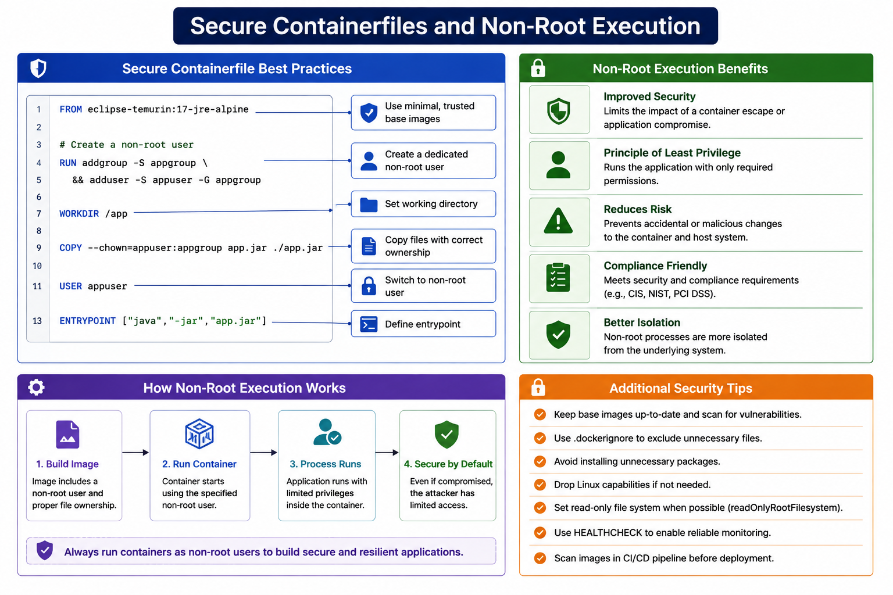
11
© 2026 by Innovation In Software Corporation
Notes:
KEY TALKING POINTS
------------------
- Secure Containerfile Best Practices
Compare the listing with the real Lab 4 Containerfile.
Both use an Alpine JRE, create a system group and user, set WORKDIR /app, give the JAR the right ownership, switch USER, and use an exec-form ENTRYPOINT.
Differences to call out: the lab uses Java 21, is multi-stage, and names its user md287.
The diagram's COPY assumes a prebuilt app.jar is in the build context.
More importantly, USER appuser is a name.
With runAsNonRoot on OpenShift, a named user cannot be verified as non-root, so use a numeric USER or set runAsUser, as the lab troubleshooting table explains.
The missing line 12 is cosmetic.
- Non-Root Execution Benefits
Improved security, least privilege, reduced risk, and better isolation all describe one idea: a compromised process that is not root can do far less inside the container and far less to the node.
Soften the Compliance Friendly row.
Running as non-root supports controls that frameworks such as CIS benchmarks and PCI DSS expect, but it does not by itself make a service compliant.
Compliance still needs scanning, access control, logging, and evidence, which Lab 4 Step 6 starts to produce.
- How Non-Root Execution Works
The four steps are sound: the image defines a non-root user and file ownership, the runtime starts the process as that user, the application runs with limited privileges, and a compromise gains limited access.
Add the OpenShift detail.
At step two the platform, not only the image, decides the UID, because restricted-v2 assigns one from the project range and the Deployment securityContext can require runAsNonRoot.
Step one should therefore also make any writable path accessible to the root group, so the image works under an arbitrary UID.
- Additional Security Tips
Most tips map directly to OpenShift settings: scan and update base images, use .dockerignore, avoid extra packages, drop Linux capabilities, set readOnlyRootFilesystem in the pod securityContext, and scan in CI before deploy, as Lab 4 Step 6 does.
Note that Spring Boot's embedded Tomcat needs a writable temp directory, so a read-only root filesystem needs an emptyDir mounted at /tmp.
Correct one tip: HEALTHCHECK does not enable monitoring on OpenShift.
Kubernetes ignores it, and Podman or Buildah drop it from OCI-format images.
Liveness, readiness, and startup probes do that job.
REAL-WORLD EXAMPLES
-------------------
- Many banks publish internal golden Containerfiles that every team must start from: an approved base image, a numeric non-root UID, no package manager in the final stage, and a mandatory pipeline scan.
Reviews then only need to check deviations from that template.
- Security benchmarks for Kubernetes, such as the CIS Kubernetes Benchmark, check for containers allowed to run as root or escalate privileges.
OpenShift's restricted-v2 SCC satisfies many of those checks by default, which is one reason regulated firms choose it.
USE-CASE SCENARIO
-----------------
Put the diagram's listing next to labs/day-04/lab4/solution/account-service/Containerfile on screen.
Ask participants to list three differences: Java 21 instead of 17, a Maven build stage in the lab, and the md287 user name with an explicit chown instead of COPY --chown.
Then run the check from Lab 4 Step 2, docker run --rm --entrypoint id md287/account-service:1.0.0, and show uid=100.
Finally, open the Account Service Deployment and point at runAsNonRoot, runAsUser, and allowPrivilegeEscalation.
The image says who should run the process, and the platform enforces it.

Slide 13
CONTAINER HEALTH CHECKS · REDUCING IMAGE SIZE AND ATTACK SURFACE · CONTAINER SECURITY BEST PRACTICES
📌
CONTAINER HEALTH CHECK BASICS
📌
STRATEGIES TO SHRINK IMAGES
✅
CONTAINER SECURITY CHECKLIST
• A HEALTHCHECK instruction defines a command the runtime periodically executes
• A failing health check can trigger a container restart independent of the orchestration platform
• In OpenShift, this is complemented (not replaced) by liveness/readiness/startup probes
• Use minimal JRE (not JDK) base images for runtime
• Use multi-stage builds so build tools never reach the final image
• Avoid unnecessary package installs and shell utilities in production images
• Use minimal, approved base images and scan them for vulnerabilities
• Run as non-root; avoid storing secrets inside images
• Pin base image versions per enterprise policy; keep dependencies minimal
KEY TAKEAWAY HEALTHCHECK in a Dockerfile is the container-runtime-level companion to the OpenShift-level liveness and readiness probes covered later. • Minimal JRE base images, multi-stage builds, and removing unnecessary tools all shrink both the download size and the attack surface. • Security isn't one setting -- it's a checklist applied consistently across every image a team builds.
12
© 2026 by Innovation In Software Corporation
Notes:
TOPIC 1 OF 3: Container Health Checks
-------------------------------------
KEY TALKING POINTS
------------------
- CONTAINER HEALTH CHECK BASICS
HEALTHCHECK runs a command inside the container at an interval.
Docker marks the container starting, healthy, or unhealthy, visible in docker ps and docker inspect.
Two corrections.
First, plain Docker does not restart an unhealthy container, because restart policies react to the process exiting.
Compose uses health status to order startup, and only Swarm replaces unhealthy tasks.
Second, OpenShift ignores the image HEALTHCHECK entirely, and Podman and Buildah drop it from OCI-format images.
Probes defined in the Deployment replace it rather than complement it.
Also, minimal images often lack curl, so a HEALTHCHECK written with curl fails silently.
REAL-WORLD EXAMPLES
-------------------
- The Lab 4 docker-compose.yml gives Postgres a pg_isready healthcheck and Kafka a topic-list healthcheck, and Account and Transaction Service wait with depends_on condition service_healthy.
That is the realistic job for container health checks: ordering local startup, not restarting production workloads.
- A team migrating from Docker Swarm to OpenShift assumes its HEALTHCHECK instructions still protect it.
After cut-over, a hung notification service keeps reporting Running for hours, because nobody defined a liveness probe and OpenShift never looked at the image health check.
USE-CASE SCENARIO
-----------------
In the capstone Deployments, Account Service has a startup probe on /actuator/health/liveness that allows 30 attempts five seconds apart, a liveness probe every 15 seconds, and a readiness probe on /actuator/health/readiness every 10 seconds.
Transaction Service uses the same pattern on port 8082.
Tell the story of transaction-db being briefly unreachable after a platform maintenance event.
The Lab 4 guide traces readiness failures to unhealthy Postgres or Kafka, so readiness goes false and the Route stops sending traffic.
Liveness stays healthy, so OpenShift does not restart a process that is fine and waiting.
None of that depends on a HEALTHCHECK in the Containerfile.
TOPIC 2 OF 3: Reducing Image Size and Attack Surface
------------------------------------------
KEY TALKING POINTS
------------------
- STRATEGIES TO SHRINK IMAGES
A JRE leaves out javac, jshell, and other development tools that a running service never needs.
Base choices include Alpine-based Temurin, as in Lab 4, and Red Hat Universal Base Image minimal or micro variants that Red Hat supports.
Alpine uses musl instead of glibc, which occasionally matters for native libraries.
Multi-stage builds keep Maven out.
Every extra package is one more thing to patch and one more scanner finding.
There is a trade-off: removing shells makes docker exec debugging harder.
On OpenShift, oc debug can start a debugging copy of a pod instead of leaving tools in the production image.
REAL-WORLD EXAMPLES
-------------------
- Regulated teams often standardize on Red Hat Universal Base Images because they receive Red Hat security updates and can be redistributed freely.
Choosing a UBI minimal JRE variant over a general-purpose OS image narrows the packages auditors and scanners must review.
- On payroll day, when a Transaction Service Deployment scales out onto nodes that have never run it, each new pod waits for the image to download before it can pass readiness.
A smaller image shortens that wait exactly when capacity is needed most.
USE-CASE SCENARIO
-----------------
After Lab 4 Step 2, have participants run docker images md287/account-service to see the image size.
Ask them to picture a single-stage build with a full Maven and JDK image as the base, carrying the source tree and the local Maven repository.
Discuss which components a scanner would flag in each.
Point out that the lab's Alpine JRE image still includes a basic BusyBox shell, which is why docker exec with /bin/sh works on the next slide.
A distroless production image would remove that shell, so teams would switch to oc debug or ephemeral debug containers.
TOPIC 3 OF 3: Container Security Best Practices
------------------------------------------
KEY TALKING POINTS
------------------
- CONTAINER SECURITY CHECKLIST
Approved base images usually come from an internal mirror the security team controls.
Scanning belongs in the pipeline, and in Lab 4 a CRITICAL finding fails the gate.
Non-root was covered earlier.
Secrets must never enter any layer: a file deleted in a later layer still exists in the earlier one, and ENV or ARG values are visible in docker history.
Pinning means choosing between a floating tag such as eclipse-temurin:21-jre-alpine, which changes as patches ship, and a digest pin updated deliberately through automation.
Keep dependencies minimal, and rescan images already in the registry as new CVEs are published.
REAL-WORLD EXAMPLES
-------------------
- A developer copies a .env file into an image and removes it in a later RUN step to be safe.
The credential still sits in the earlier layer, and anyone who can pull the image from the registry can extract it.
The only real fix is to rotate the credential and rebuild without it.
- Security researchers have repeatedly reported finding cloud access keys and API tokens inside publicly available container images.
That is why secret scanning of image layers is now a common pipeline stage alongside vulnerability scanning.
USE-CASE SCENARIO
-----------------
Map the checklist to Lab 4 Step 6.
Participants fill in Exercise 4.3, starter/pipeline/OWNERSHIP.md, naming who owns scan, SBOM, sign, and promote.
They run tools/run-pipeline-locally.ps1 and see scan PASS on sample-scan-pass.json and FAIL on sample-scan-fail.json, which contains a CRITICAL finding.
The signature step prints the Cosign verify command.
Meanwhile the capstone Secret, md287-db-secrets, holds the database passwords and JWT secret outside the image entirely.
Each checklist line now has a named owner and a piece of evidence, which is what a bank's release review asks for.

Slide 14
SUPPLY-CHAIN SECURITY AND SBOMS · TESTING CONTAINERS LOCALLY
📌
WHY SBOMS MATTER
📌
LOCAL TEST LOOP
• An SBOM inventories every dependency and library baked into an image
• Enables fast vulnerability response: search the SBOM instead of re-scanning blindly
• Increasingly a compliance and enterprise procurement requirement
1. docker build -t account-service:1.0.0 .
2. docker run -p 8081:8080 account-service:1.0.0
3. curl http://localhost:8081/actuator/health to verify it started correctly
KEY TAKEAWAY A Software Bill of Materials turns 'is this image affected by CVE-XXXX' from a guess into a searchable answer. • docker build, docker run -p, and curl the health endpoint form the minimum local test loop before pushing to a registry.
13
© 2026 by Innovation In Software Corporation
Notes:
TOPIC 1 OF 2: Supply-Chain Security and SBOMs
------------------------------------------
KEY TALKING POINTS
------------------
- WHY SBOMS MATTER
An SBOM lists components, versions, and usually package identifiers and hashes, in standard formats such as SPDX or CycloneDX.
Tools like Syft, or the CycloneDX Maven plugin, generate one at build time, and Cosign can attach it to the image as a signed attestation.
When a new CVE is announced, teams query stored SBOMs for the affected package and version across every image, instead of rescanning the registry.
Lab 4 ships tools/sample-sbom-account-service.json, which lists spring-boot-starter-web 3.4.5 and Temurin 21.
United States federal cybersecurity policy has pushed software suppliers toward providing SBOMs, and bank procurement teams increasingly ask vendors for them.
REAL-WORLD EXAMPLES
-------------------
- When the Log4Shell vulnerability, CVE-2021-44228, was disclosed, organizations with component inventories could quickly list which applications bundled log4j-core.
Others spent days searching servers and unpacking JAR files by hand to find out whether they were exposed.
- US Executive Order 14028 on improving the nation's cybersecurity directed federal guidance on software supply-chain security, including SBOMs, and NTIA published the minimum elements an SBOM should contain.
Vendors that sell to government and large banks now routinely receive SBOM requests.
USE-CASE SCENARIO
-----------------
The Lab 4 guide puts it this way: an SBOM is how you answer what you actually shipped after a new CVE drops on a Friday.
Play that out for the capstone.
A critical advisory lands against a specific Spring Web version on a Friday afternoon.
The on-call engineer opens the stored SBOMs for account-service 1.0.0 and transaction-service 1.0.0, searches for spring-boot-starter-web, and within minutes reports which images carry the affected version and which running Deployments use them.
Only then do they trigger a rebuild, rescan, and rollout, instead of rescanning every image in the cluster.
TOPIC 2 OF 2: Testing Containers Locally
----------------------------------------
KEY TALKING POINTS
------------------
- LOCAL TEST LOOP
Build, run, and probe is the right habit, but adapt the commands for the capstone.
The lab build uses -f with the Lab 4 Containerfile, the Lab 3 solution module as context, and the tag md287/account-service:1.0.0.
Account Service listens on 8081 inside the container, so the mapping is 8081:8081, not 8081:8080.
A bare docker run has no PostgreSQL, so the service will not become healthy.
Lab 4 therefore uses docker compose up -d --build and calls /actuator/health/liveness and /actuator/health/readiness with curl.exe, because in Windows PowerShell 5.1 curl is an alias for Invoke-WebRequest.
Add the non-root check with docker run --rm --entrypoint id.
REAL-WORLD EXAMPLES
-------------------
- A team pushes an image whose ENTRYPOINT points at a JAR path that does not exist in the final stage.
On the cluster it appears only as CrashLoopBackOff after a pipeline run and a rollout.
A quick local run would have shown the Java error message immediately.
- Engineers following Linux-based tutorials on Windows often type curl in PowerShell and get an Invoke-WebRequest error or unexpected output.
Calling curl.exe explicitly, as the MD287 lab guides do, avoids that trap.
USE-CASE SCENARIO
-----------------
Walk through Lab 4 Step 4 as the capstone's local loop.
After docker compose up -d --build, the participant waits for Flyway to finish.
They call liveness and readiness on 8081 and readiness on 8082 without a token and expect 200.
They check /actuator/info for version 1.0.0, and call /actuator/metrics with a teller JWT.
Then they create and activate an account, post a transaction with the header X-Correlation-Id: lab4-demo, and confirm the logs show correlationId=lab4-demo and never the Authorization header.
Only after this loop passes do they log in to ARO and push, because failures are far cheaper to diagnose here than in a pod.

Slide 15
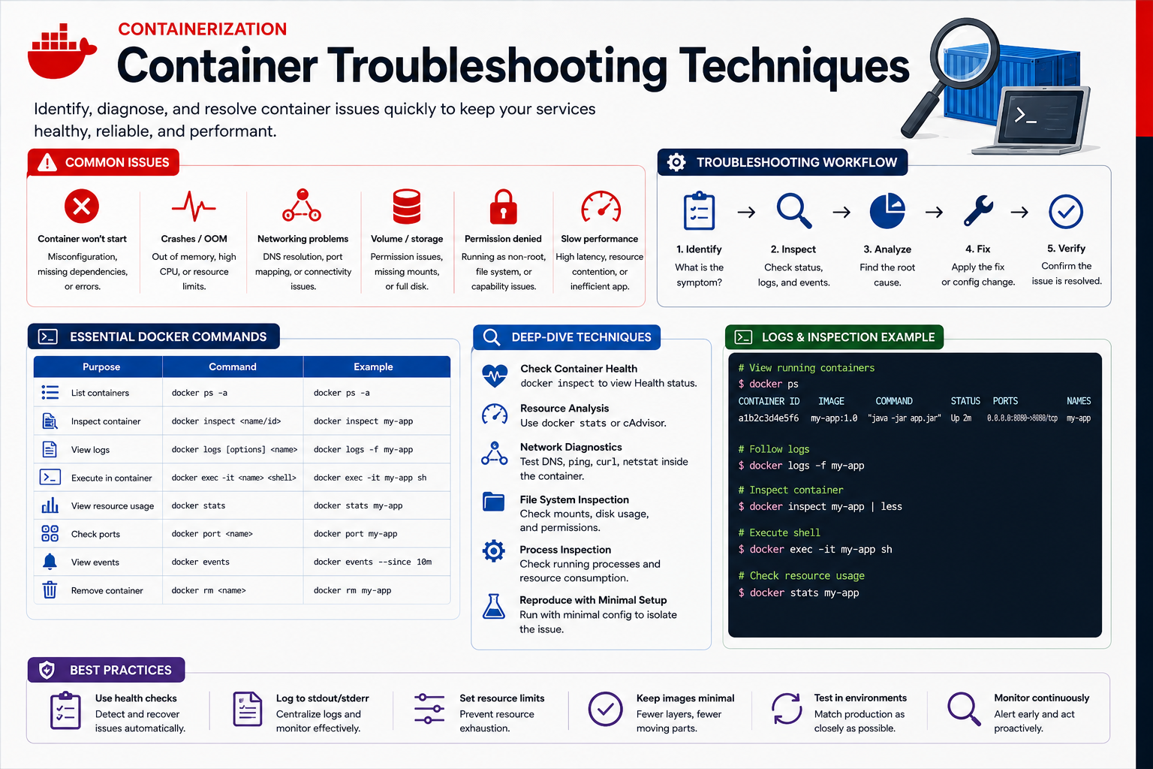
14
© 2026 by Innovation In Software Corporation
Notes:
KEY TALKING POINTS
------------------
- CORE TROUBLESHOOTING COMMANDS
docker ps -a shows every container, including exited ones, with an exit status.
Exit code 137 means the process was killed, often by a memory limit, and code 1 usually means the application failed at startup.
docker logs works even on stopped containers, so it is the first command for a container that exits immediately, and in the lab the names are md287-lab4-account and md287-lab4-transaction.
docker exec -it opens a shell, but only in a running container that has a shell.
The Alpine JRE image has /bin/sh, while a distroless image would not.
docker inspect shows the effective environment, mounts, network, and health status.
- Common Issues and Troubleshooting Workflow
The six issue cards match what participants actually hit in Lab 4: a container that will not start due to a bad JAR path or missing configuration, OOM kills, networking or port conflicts, storage and permission problems when running as non-root, and slow startup.
One refinement: high CPU does not crash a container.
A CPU limit throttles it, while memory limits kill.
The five-step workflow is the discipline to teach: state the symptom, gather status, logs, and events before changing anything, find the root cause, apply one fix, then verify.
- Essential Docker Commands and Logs Example
The table and the terminal panel use a generic my-app image on port 8080.
Translate them to the capstone: docker logs -f md287-lab4-transaction to follow Transaction Service, docker stats to watch memory against the JVM heap, docker port to confirm 8081 and 8082 are published, and docker events to see restarts.
Remind the room that docker rm deletes the container's writable layer and its log history, so capture logs before removing a failing container.
- Deep-Dive Techniques and Best Practices
Correct one deep-dive line: docker inspect shows a Health status only when a health check is defined.
The Lab 4 Postgres and Kafka containers get one from Compose, but the application images do not.
Network diagnostics from inside a container need tools a minimal image may lack.
Reproducing with a minimal setup is excellent advice.
The best-practice row lines up with this module: use health checks, which on OpenShift means probes, log to stdout and stderr, set resource limits, keep images minimal, test in production-like environments, and monitor continuously.
REAL-WORLD EXAMPLES
-------------------
- A payments container exits seconds after starting and docker exec fails because nothing is running.
docker ps -a shows exit code 1, and docker logs shows Spring Boot reporting that it cannot connect to the database.
The fix is in configuration, and no shell access was ever needed.
- An account-statement service keeps restarting under load, and docker ps -a shows exit code 137.
docker stats shows memory climbing to the container limit, which points the team at JVM heap settings and the memory limit rather than at application logic.
USE-CASE SCENARIO
-----------------
During Lab 4 Step 4, a participant reports that Transaction Service readiness never returns 200.
Model the five-step workflow out loud.
Identify: readiness fails on 8082.
Inspect: docker compose ps shows Kafka unhealthy, and docker logs md287-lab4-transaction --tail 40 shows broker connection errors.
Analyze: the kafka-init container has not completed, so the topics do not exist.
Fix: wait for kafka-init, or restart the Kafka service.
Verify: readiness returns 200, and the transaction moves from RECEIVED to SUBMITTED.
Then give the ARO equivalents they will need in Step 5: oc get pods, oc logs, oc logs --previous, oc describe pod, oc get events, and oc rsh.

Slide 16
KUBERNETES AND OPENSHIFT OVERVIEW · KUBERNETES VS. RED HAT OPENSHIFT · OPENSHIFT ARCHITECTURE
📌
WHAT OPENSHIFT PROVIDES
📌
WHAT OPENSHIFT ADDS ON TOP OF KUBERNETES
• Container orchestration and deployment automation built on Kubernetes
• Networking, routing, security controls, image management, monitoring
• Developer workflows: web console, oc CLI, image streams, builds
• Security Context Constraints (SCCs) enforce non-root and least-privilege by default
• Routes (vs. plain Ingress), Image Streams, and BuildConfigs for developer workflows
• An integrated web console, registry, and CI/CD-friendly build pipeline
📌
CORE OPENSHIFT CONCEPTS
🏦
BANKING EXAMPLE
• Cluster, node, pod, deployment, service, route, project
• ConfigMap, secret, image stream, operator
• Assigned OpenShift project containing Account Service and Transaction Service deployments, each with pods, a service, and a route
KEY TAKEAWAY Container orchestration, networking, routing, security, image management, and developer workflows all come bundled with OpenShift. • Vanilla Kubernetes gives you the primitives; OpenShift adds Security Context Constraints, Routes, Image Streams, and BuildConfigs on top. • Pods run on worker nodes, deployments manage pods, services provide stable networking, and routes expose selected services externally.
15
© 2026 by Innovation In Software Corporation
Notes:
TOPIC 1 OF 3: Kubernetes and OpenShift Overview
------------------------------------------
KEY TALKING POINTS
------------------
- WHAT OPENSHIFT PROVIDES
At its core, OpenShift Container Platform is a Kubernetes distribution: scheduling, self-healing, and rolling updates come from Kubernetes.
Red Hat adds cluster networking and DNS, a router that serves Routes, security defaults through SCCs and integrated authentication with RBAC, an internal image registry with image streams, and a preinstalled Prometheus-based monitoring stack.
For developers there is the web console, the oc CLI, which also accepts familiar kubectl commands, and in-cluster builds.
The classroom cluster is Azure Red Hat OpenShift, a managed OpenShift service jointly operated by Microsoft and Red Hat, so nobody in class installs or upgrades the cluster.
REAL-WORLD EXAMPLES
-------------------
- Many large financial institutions run OpenShift both in their own data centers and on public clouds, so application teams use the same manifests, oc commands, and security model wherever a workload lands.
That makes hybrid-cloud and data-centre exit plans far less disruptive.
- Before container platforms, an enterprise IT group might maintain separate VM build scripts, patching schedules, and load-balancer tickets for every application.
On OpenShift the same outcome is declared in a few YAML manifests applied with oc apply, and the platform handles placement and restarts.
USE-CASE SCENARIO
-----------------
Summarize the participant's Day 4 journey in platform terms.
On the VM they build md287/account-service:1.0.0 with Docker Desktop.
After oc login to the ARO API, the internal registry receives the pushed image.
In their md287 project, Deployments schedule pods onto worker nodes, the platform restarts containers whose liveness probes fail, Services give account-service and transaction-service stable names, and Routes publish HTTPS endpoints.
The platform team has also pre-provisioned account-db, transaction-db, and Kafka in the same project.
The participant writes no load-balancer rules, VM scripts, or certificate requests.
TOPIC 2 OF 3: Kubernetes vs. Red Hat OpenShift
------------------------------------------
KEY TALKING POINTS
------------------
- WHAT OPENSHIFT ADDS ON TOP OF KUBERNETES
SCCs control which UIDs, capabilities, and volume types a pod may use, and the default restricted-v2 SCC is why root-assuming images fail.
Routes existed before Kubernetes Ingress and support edge, passthrough, and re-encrypt TLS, while OpenShift still accepts standard Ingress objects.
Image Streams track image tags and can trigger redeploys, and BuildConfigs run Source-to-Image or Containerfile builds inside the cluster.
The console and registry come built in.
CI/CD needs a caveat: OpenShift Pipelines, based on Tekton, and OpenShift GitOps, based on Argo CD, are operators that must be installed, which is why Lab 4 includes a local pipeline script fallback.
REAL-WORLD EXAMPLES
-------------------
- A vendor Helm chart written for vanilla Kubernetes often runs its container as root.
Installed unchanged on OpenShift, its pods fail SCC admission or hit permission errors.
Teams then ask the vendor for an OpenShift-certified image or adjust the chart, rather than granting broad privileged access.
- On vanilla Kubernetes, exposing a service over HTTPS usually means installing an ingress controller and a certificate manager.
On OpenShift, a Route with edge termination, like the Lab 4 Account Service Route with its HTTP-to-HTTPS redirect, works with the cluster's default router certificate.
USE-CASE SCENARIO
-----------------
Ask the capstone team how portable their Lab 4 manifests are.
The Deployment, Service, ConfigMap, and Secret are standard Kubernetes objects that would apply almost unchanged to another Kubernetes platform.
The Route uses the route.openshift.io API and would become an Ingress elsewhere.
The securityContext settings are portable, but the reason pods behave the way they do, restricted-v2 SCC admission, is OpenShift-specific.
The team also chose standard apps/v1 Deployments rather than OpenShift's older DeploymentConfig, which recent OpenShift releases have deprecated.
Portability was a deliberate design decision.
TOPIC 3 OF 3: OpenShift Architecture
------------------------------------
KEY TALKING POINTS
------------------
- CORE OPENSHIFT CONCEPTS
A cluster is a control plane that stores and reconciles desired state, plus worker nodes that run pods.
On ARO, Microsoft and Red Hat operate the control plane.
A pod wraps one or more containers.
A Deployment manages ReplicaSets, which keep the requested number of pods running and handle rollouts.
A Service gives pods a stable DNS name, and a Route publishes a Service outside the cluster.
A project is a namespace with RBAC and quotas.
ConfigMaps hold settings, and Secrets hold sensitive values, base64-encoded and protected by access control.
Image streams track images, and operators automate platform components, such as the AMQ Streams operator for Kafka.
- BANKING EXAMPLE
This is exactly the Lab 4 end state.
Each participant's project, md287 followed by their username, contains an account-service Deployment with one replica on port 8081, a matching Service, and an edge-TLS Route.
Transaction-service follows the same pattern on port 8082.
Beside them sit the account-config and transaction-config ConfigMaps, the md287-db-secrets Secret, and pre-provisioned account-db, transaction-db, and Kafka Services on port 19092.
Transaction Service calls Account Service through the internal Service URL, http://account-service:8081, not through the Route, because the Route is only for traffic from outside the cluster.
REAL-WORLD EXAMPLES
-------------------
- In a typical bank layout, a core ledger service has only an internal Service, reachable by other workloads in the cluster, while customer-facing APIs receive Routes and sit behind an API gateway.
Keeping internal services off Routes shrinks the externally reachable surface.
- Red Hat AMQ Streams, part of the course stack, uses an operator to manage Kafka clusters on OpenShift.
Platform teams declare a Kafka custom resource, and the operator creates brokers, handles rolling upgrades, and manages certificates, which is how the classroom Kafka Service can simply be pre-provisioned.
USE-CASE SCENARIO
-----------------
Trace one request through the capstone architecture.
A tester runs curl.exe against the Account Service Route host from the Lab 4 guide.
The OpenShift router terminates TLS and forwards to the account-service Service, which picks a Ready pod on a worker node.
Spring Boot on port 8081 validates the JWT and queries account-db through its Service name.
Later, Transaction Service receives a new transaction, calls http://account-service:8081 to check the account is ACTIVE, and publishes an event to kafka:19092.
If the Account pod is replaced during a rollout, the Service name never changes and the Route host stays the same.

Slide 17
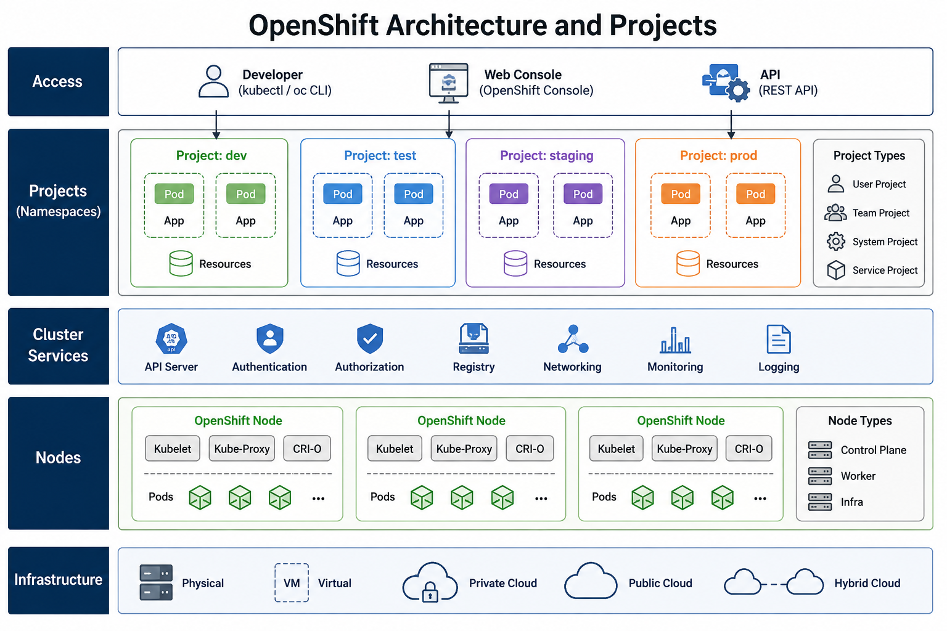
16
© 2026 by Innovation In Software Corporation
Notes:
KEY TALKING POINTS
------------------
- Access
All three entry points talk to the same Kubernetes API server, so the CLI, the console, and a pipeline calling the REST API all go through the same authentication and RBAC checks.
Nothing gets around the API.
In Lab 4 participants run oc login against https://api.aro-md287.centralus.aroapp.io:6443/ and can open the console on the cluster apps domain.
kubectl also works, but oc adds OpenShift commands such as oc login, oc project, and oc new-project, and it understands Routes and image streams.
- Projects (Namespaces)
A project is a Kubernetes namespace with extra OpenShift metadata and default access rules.
The diagram puts dev, test, staging, and prod in one cluster.
Plenty of banks run production on separate clusters and use projects inside each cluster to separate teams and applications.
In our classroom each participant gets exactly one pre-created project, md287-<username>, with edit rights only there.
The Project Types legend is an informal grouping, not an OpenShift field.
System projects are the openshift-* and kube-* namespaces, and nobody deploys applications into those.
- Cluster Services
These are shared platform features that every project uses.
The API server is the front door.
Authentication is OAuth-based login.
Authorization is RBAC.
The integrated image registry stores images.
Networking covers the software-defined pod network and the router that serves Routes.
Monitoring is the built-in Prometheus-based stack.
Logging is usually added through an operator.
Lab 4 touches several of these: participants push images to the integrated registry, reach their services through Routes, and view pod metrics in the console.
The API server is part of the control plane.
The diagram lists it here because every action goes through it.
- Nodes
Every node runs the kubelet, the agent that starts pods and runs their probes.
Every node also runs CRI-O, the container runtime OpenShift uses in place of Docker.
The Node Types legend adds infra nodes, which some clusters use to keep the router, registry, and monitoring away from application pods.
One correction: the kube-proxy box is generic Kubernetes.
Current OpenShift 4 clusters use the OVN-Kubernetes network plugin, which handles Service routing itself, so you normally will not find kube-proxy pods.
The job still gets done.
A different component does it.
- Infrastructure
OpenShift works the same way on bare metal, virtual machines, private cloud, public cloud, and a hybrid of these.
Portability is a big reason banks choose it: the same Deployment YAML and the same oc commands work in an on-premises data center and in the cloud.
Our classroom cluster is Azure Red Hat OpenShift (ARO) in Central US, a managed service that Microsoft and Red Hat operate together.
Participants never manage the virtual machines underneath.
They only see their project.
REAL-WORLD EXAMPLES
-------------------
- A retail bank might run OpenShift on premises for core deposit and payment systems that must stay in its own data centers, and managed OpenShift in a public cloud for mobile banking APIs.
Teams use the same oc commands and the same YAML in both places.
- A card authorisation platform team might keep separate projects for development, testing, and performance testing, with resource quotas on each.
Only the release engineering group holds deploy rights in the production cluster, so developers can experiment freely without any path to live cardholder traffic.
USE-CASE SCENARIO
-----------------
Walk the room through what happens when a participant deploys Account Service in Lab 4.
They run oc login, and the API server checks who they are.
They run oc apply on 10-account.yaml in md287-<username>, and RBAC confirms they have edit rights in that project.
The Deployment is saved in cluster state, the scheduler picks a worker node, and the kubelet on that node asks CRI-O to pull the account-service image from the integrated registry and start it.
The router then publishes the account-service Route on the ARO apps domain.
Every band of this diagram took part in a single oc apply.

Slide 18
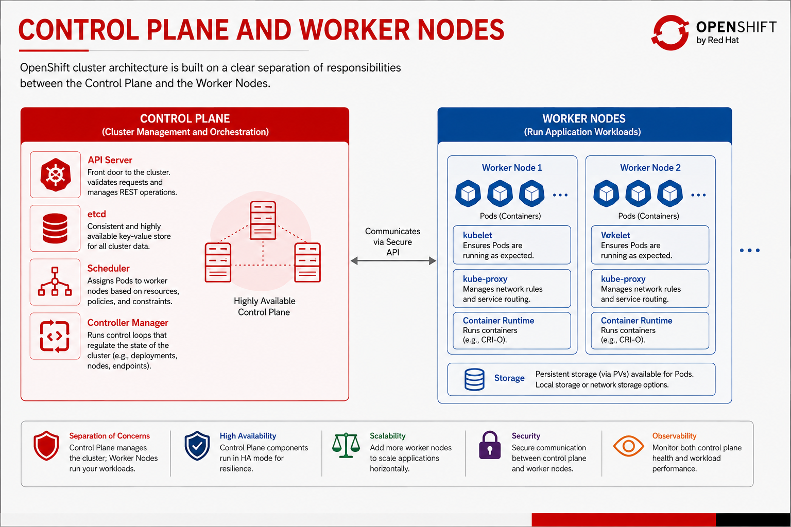
17
© 2026 by Innovation In Software Corporation
Notes:
KEY TALKING POINTS
------------------
- CONTROL PLANE VS. WORKER NODES
The control plane is the cluster's brain.
It stores the desired state, decides where work runs, and keeps correcting any drift from that state.
Worker nodes are the muscle.
They run the pods the control plane assigns to them.
OpenShift keeps the two roles on separate machines so that a runaway application cannot starve the components that manage the cluster.
On ARO the three control plane nodes are part of the managed service.
Participants' pods always land on worker nodes, and nobody in class can schedule onto the control plane.
- Control Plane components
The API server is the only component that talks to etcd, and every client, including the other control plane components, goes through the API server.
etcd is a consistent key-value store that holds all cluster state, including Deployments, Secrets, and ConfigMaps.
The scheduler picks a node for each new pod based on resource requests, affinity rules, and taints, but it does not start the pod.
The controller manager runs reconcile loops for Deployments, ReplicaSets, and endpoints.
OpenShift adds its own API server and controllers for Routes, builds, and image streams.
- Worker Nodes components
On each worker, the kubelet watches the API for pods assigned to its node, asks the container runtime to start them, and runs their liveness, readiness, and startup probes.
On OpenShift the container runtime is CRI-O.
The kube-proxy box is generic Kubernetes; OpenShift's OVN-Kubernetes network plugin provides that Service routing on current clusters.
Also note a typo in the image: Worker Node 2 reads Wokelet, which should be kubelet.
The Storage row reminds you that pods can use persistent volumes, covered a few slides later.
- Principles strip
The bottom strip summarizes why this split matters.
Separation of concerns means platform management is kept apart from application workloads.
High availability means the control plane runs as several replicas, so losing one node does not stop the cluster.
Scalability means you add worker nodes when applications need more capacity.
Security means control plane and nodes talk over authenticated TLS.
Observability means operators watch both control plane health and workload health, which leads into Day 4's monitoring theme.
REAL-WORLD EXAMPLES
-------------------
- During a heavy payroll run, a bank's Transaction Service pods may use most of the CPU on the worker nodes.
Because the API server, scheduler, and etcd run on separate control plane nodes, operators can still scale deployments and roll back releases while those workers are under pressure.
- When a worker node fails its health checks in a card-processing cluster, the control plane marks the node unready, and controllers recreate its replicated pods on healthy workers.
Services keep answering while the infrastructure team replaces the bad machine.
USE-CASE SCENARIO
-----------------
Suppose one ARO worker node goes down in the middle of Lab 4 while several participants have Account Service pods running on it.
Nobody in class touches the control plane.
The node controller notices the kubelet has stopped reporting and marks the node unhealthy.
The ReplicaSet controller sees that each account-service Deployment now has fewer running pods than requested.
The scheduler places replacement pods on other workers, and those nodes' kubelets pull the images and start the containers.
Once readiness probes pass, the account-service Services send traffic to the new pods.
Participants may notice a restart and a new pod name, and that is all.

Slide 19
OPENSHIFT PROJECTS AND NAMESPACES · PODS AND REPLICASETS · DEPLOYMENTS AND DEPLOYMENTCONFIGS
📌
WHY PROJECTS MATTER
📌
PODS AND REPLICASETS
• Separate development, test, staging, and production environments
• Support team ownership, access control, and resource quotas
• oc new-project, oc project, and oc get all are the core commands
• A pod usually contains one application container, though it can contain more
• A ReplicaSet ensures a specified number of pod replicas are running at any given time
• Deployments manage ReplicaSets, which in turn manage pods
📌
WHAT A DEPLOYMENT MANAGES
✅
DEPLOYMENT VS. DEPLOYMENTCONFIG
• Which container image to run, how many replicas, environment variables, rollout strategy
• oc rollout status / history / undo manage and inspect rollouts
• Deployment: Kubernetes-native, portable, now the recommended default
• DeploymentConfig: OpenShift-specific, older, with some OpenShift-only trigger behaviors
KEY TAKEAWAY banking-dev, banking-test, banking-staging, and banking-prod each isolate the same services with different configuration and access rules. • If a pod fails, its ReplicaSet notices and creates a replacement automatically -- no manual intervention required. • Kubernetes-native Deployments are now preferred over OpenShift's older DeploymentConfig for most new Spring Boot workloads.
18
© 2026 by Innovation In Software Corporation
Notes:
TOPIC 1 OF 3: OpenShift Projects and Namespaces
------------------------------------------
KEY TALKING POINTS
------------------
- WHY PROJECTS MATTER
A project gives the same set of services a separate space per environment or team, with its own ConfigMaps, Secrets, RBAC, and quotas.
That is how banking-dev can let developers deploy freely while banking-prod allows deploys only by a release group.
Quotas keep one team from using up shared cluster capacity.
On the commands: oc new-project creates a project, but in class projects are pre-created, so participants only run oc project md287-<username> and skip 00-namespace.yaml.
Also note that oc get all does not list ConfigMaps or Secrets, which is why Lab 4 runs oc get deploy,svc,route,cm,secret.
REAL-WORLD EXAMPLES
-------------------
- A mortgage lending team might run loan-origination-dev, loan-origination-test, and loan-origination-prod projects.
Developers get edit rights in dev, testers get view rights in test, and only a change-managed release service account can deploy to prod.
- A shared cluster at a large bank might put a resource quota on each line-of-business project, so a runaway statement-generation batch job in one project cannot take all the CPU the fraud screening services need.
USE-CASE SCENARIO
-----------------
In Lab 4 every participant deploys the same Account Service and Transaction Service, all on one ARO cluster.
Nobody's work collides because each person works in md287-<username>.
Their account-service Deployment, account-config ConfigMap, and md287-db-secrets Secret exist only in their project.
The backing account-db, transaction-db, and kafka Services are pre-provisioned in each project too.
If a participant tries oc get pods -n md287-someoneelse, the API returns Forbidden.
That is project isolation and RBAC working exactly as they would between a bank's dev and prod environments.
TOPIC 2 OF 3: Pods and ReplicaSets
----------------------------------
KEY TALKING POINTS
------------------
- PODS AND REPLICASETS
A pod is the smallest unit OpenShift schedules.
Its containers share one network identity and can share volumes, so a helper sidecar can reach the main app on localhost.
A ReplicaSet uses a label selector such as app=account-service to count matching pods and creates or removes pods to match the replica count.
One nuance: if a container crashes, the kubelet restarts it inside the same pod.
The ReplicaSet steps in when a pod is deleted, evicted, or lost with its node.
You never manage ReplicaSets directly.
The Deployment owns them and keeps older ones around for rollback.
REAL-WORLD EXAMPLES
-------------------
- A bank's balance inquiry service might run three pod replicas.
When a routine node patching window drains one worker, the evicted pod's ReplicaSet creates a replacement on another node, and mobile app users keep seeing balances with no manual action.
- A payments team that adds a log-shipping sidecar to its pods gets two containers sharing one network identity.
The sidecar reads the application's log files from a shared volume, and both containers start and stop together as one pod.
USE-CASE SCENARIO
-----------------
During Lab 4, ask a participant to delete their running Account Service pod with oc delete pod and then watch oc get pods.
Within seconds a new pod with a different name suffix appears, because the ReplicaSet that the account-service Deployment owns sees zero pods against a desired count of one and creates a new pod.
Then run oc get rs.
After the Step 7 rollout and undo, they will see more than one ReplicaSet for the Deployment, which is the history oc rollout undo uses.
That single deletion shows the whole ownership chain the slide describes.
TOPIC 3 OF 3: Deployments and DeploymentConfigs
------------------------------------------
KEY TALKING POINTS
------------------
- WHAT A DEPLOYMENT MANAGES
A Deployment is the desired-state record for one service.
It sets which image to run, how many replicas, which environment variables and ConfigMap or Secret references to use, which probes and resources to apply, and how to roll out changes.
When the pod template changes, it creates a new ReplicaSet and moves pods over gradually.
oc rollout status waits until the rollout finishes or fails, oc rollout history lists revisions, and oc rollout undo goes back to the previous revision.
Lab 4 Step 7 uses all three on account-service.
- DEPLOYMENT VS. DEPLOYMENTCONFIG
A Deployment (apiVersion apps/v1) works on any Kubernetes distribution, so the manifests and skills carry over.
A DeploymentConfig is OpenShift-only.
It came before Deployments and added features such as automatic rollouts when an image stream tag changes.
Red Hat has deprecated DeploymentConfig since OpenShift 4.14.
It still runs, but new work should use Deployments, and an image-change trigger can be added to a Deployment with an annotation.
Existing DeploymentConfigs in older bank applications are candidates for migration.
Lab 4's 10-account.yaml and 20-transaction.yaml are plain Deployments.
REAL-WORLD EXAMPLES
-------------------
- A bank moving an older OpenShift 3 era statements application onto a current cluster will often find DeploymentConfigs with image-change triggers.
The usual migration rewrites them as Deployments, so the same manifests can also run on other Kubernetes platforms the bank uses.
- When a release of a fraud scoring API causes a spike in 5xx errors, the on-call engineer runs oc rollout undo on that Deployment.
The previous ReplicaSet scales back up in minutes, without waiting for a rebuild or a code fix.
USE-CASE SCENARIO
-----------------
In Lab 4 Step 7 a participant runs oc set env deploy/account-service INFO_APP_VERSION=1.0.1.
That changes the pod template, so the Deployment creates a new ReplicaSet, and oc rollout status reports progress until the new pod is ready.
Calling /actuator/info through the Route now shows version 1.0.1.
They then run oc rollout undo, watch the status again, and check oc rollout history, which shows more than one revision.
The info endpoint is back to 1.0.0.
That is the exact rehearsed-rollback routine a bank wants before a Friday production release.

Slide 20
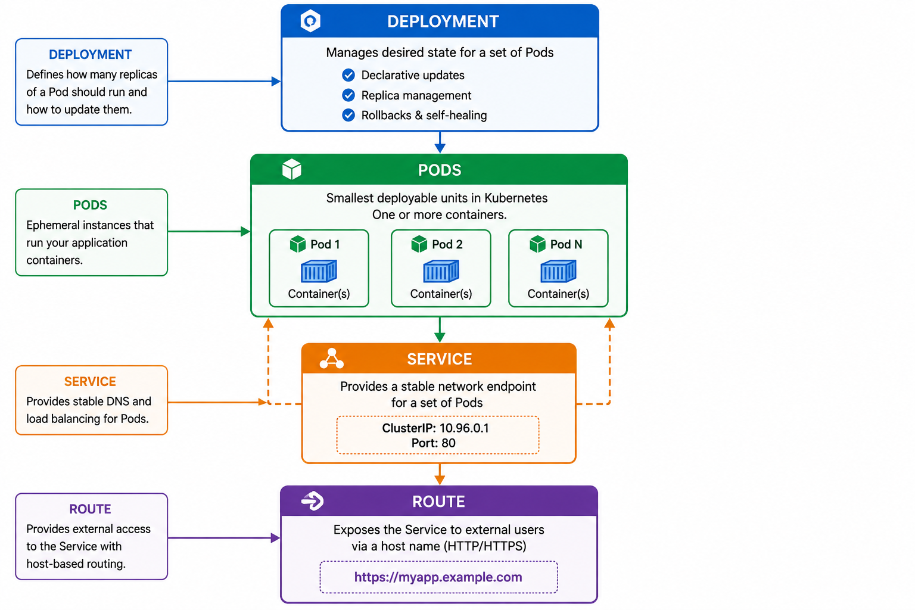
19
© 2026 by Innovation In Software Corporation
Notes:
KEY TALKING POINTS
------------------
- Deployment
The top box is the desired-state record: which image, how many replicas, and how to update.
Its three checkmarks are declarative updates (change the YAML, not the pods), replica management (through a ReplicaSet), and rollbacks with self-healing (undo to a previous revision, and replace lost pods).
In the capstone this is account-service in 10-account.yaml, with one replica, image md287/account-service:1.0.0 until oc set image points it at the internal registry, plus probes, resources, and runAsNonRoot.
- Pods
The green box shows replicas as interchangeable, short-lived instances.
Pod 1, Pod 2, and Pod N run the same image, and any of them can be replaced at any time with a new name and a new IP address.
That is why nothing should hold on to a specific pod.
Each pod holds one or more containers.
In Lab 4 each pod runs a single Spring Boot container listening on 8081 for Account Service or 8082 for Transaction Service, as user md287 rather than root.
- Service
The orange box gives the changing set of pods one stable name and virtual IP.
Its dashed arrows show it selecting pods by label and spreading traffic across the ready ones.
The ClusterIP 10.96.0.1 and Port 80 values are placeholders.
OpenShift clusters commonly use a 172.30 service address range, and in the lab the account-service Service listens on port 8081 and forwards to targetPort 8081.
Nobody types the IP anyway, because other services call the DNS name account-service.
- Route
The purple box is OpenShift's way of reaching a Service from outside the cluster over HTTP or HTTPS using a hostname.
The example host myapp.example.com is generic.
In class the router generates a host from the Route name and project on the ARO apps domain, for example account-service-md287-<username>.apps.aro-md287.centralus.aroapp.io.
Lab 4 Routes use edge TLS termination and redirect plain HTTP to HTTPS.
A Route is only for external access.
Internal calls go straight to the Service.
- Left-hand explanation cards
The four cards on the left repeat each box's job in one sentence, which works well as a recap or a quick quiz.
One point to clarify about the arrows: the downward arrows show how the resources build on each other, not the direction of traffic.
A real request comes in the other way, from the client to the Route, through the router, to the pods behind the Service.
In practice the OpenShift router uses the Service's endpoint list and sends traffic directly to the ready pods.
REAL-WORLD EXAMPLES
-------------------
- A bank's customer-facing card-controls API, the one that lets customers freeze a lost card, needs a Route, usually behind an API gateway.
The internal ledger lookup it calls has only a Service and is never reachable from outside the cluster.
- When a bank's statement service scales from two pods to six ahead of month-end, callers change nothing.
The Service name stays the same, the new pods join once their readiness probes pass, and the Route hostname never changes.
USE-CASE SCENARIO
-----------------
Trace one capstone request.
A tester calls https://account-service-md287-<username>.apps.aro-md287.centralus.aroapp.io/actuator/health/readiness.
The router terminates TLS for the edge Route named account-service and forwards the request to a ready pod behind the account-service Service on port 8081.
That pod exists because the account-service Deployment asked for one replica.
Separately, Transaction Service calls http://account-service:8081 from inside the project when it validates an account.
That internal call never touches the Route.
Asking participants to name which resource is responsible at each step is a quick check that the diagram landed.

Slide 21
SERVICES AND INTERNAL NETWORKING · ROUTES AND EXTERNAL ACCESS · CONFIGMAPS AND SECRETS
📌
HOW SERVICES WORK
✅
SERVICE DISCOVERY
📌
HOW ROUTES WORK
• A Service is a stable virtual IP and DNS name that provides reliable access to a set of Pods
• Services use label selectors to route traffic to matching Pods via endpoints
• Types: ClusterIP (default, internal-only), NodePort, LoadBalancer, ExternalName
• Services register automatically in DNS as <service-name>.<namespace>.svc.cluster.local
• Pod-to-pod communication uses pod IPs directly, with no NAT and high performance
• External Client -> Ingress Controller -> Route -> Service -> Pods
• Route types: Edge (TLS terminates at ingress, most common) and Re-encrypt (re-encrypts to the service)
✅
WHEN TO CREATE A ROUTE
📌
CONFIGMAPS: NON-SENSITIVE DATA
🔒
SECRETS: SENSITIVE DATA
• Public API endpoints, test endpoints, admin UIs, API gateway integration points
• Do not create external Routes for services that should remain internal-only
• Application configuration properties, feature flags, UI settings, log levels
• Database credentials, API keys/tokens, TLS certificates and private keys, OAuth client secrets
• Never store secrets in ConfigMaps; restrict access using RBAC and rotate regularly
KEY TAKEAWAY Transaction Service calls http://account-service:8081, not a pod IP -- OpenShift load-balances that call across every healthy Account Service pod. • Edge, re-encrypt, and passthrough TLS termination each trade off where encryption happens between the client and the pod. • Both can be mounted as files or injected as environment variables -- the only difference is that Secrets are base64-encoded and access-restricted.
20
© 2026 by Innovation In Software Corporation
Notes:
TOPIC 1 OF 3: Services and Internal Networking
------------------------------------------
KEY TALKING POINTS
------------------
- HOW SERVICES WORK
A Service is a stable front for pods that come and go.
Its selector, for example app: account-service, matches pod labels, and the platform keeps an endpoint list of matching pods that are ready.
Pods that fail readiness are dropped from the list automatically.
ClusterIP is the default and is internal only, which is what the lab uses.
NodePort and LoadBalancer expose a port on nodes or a cloud load balancer, but on OpenShift HTTP traffic normally comes in through Routes instead.
ExternalName is a DNS alias to a host outside the cluster.
- SERVICE DISCOVERY
Every Service gets a DNS record in the form <service>.<namespace>.svc.cluster.local.
Inside the same project the short name account-service resolves, which is why the lab ConfigMap sets MD287_ACCOUNT_SERVICE_BASE_URL to http://account-service:8081.
The second bullet describes the Kubernetes network model: pods can reach each other's IPs directly without NAT.
That is how the network works, not advice.
Application code should still call Service names, because pod IPs change every time a pod is replaced.
REAL-WORLD EXAMPLES
-------------------
- A bank's funds transfer service might call a limits service at http://limits-service:8080.
When the limits team scales from two pods to five for a payroll run, the transfer service needs no config change, because the Service spreads calls across whichever pods are ready.
- A common production incident: a team changes the pod labels in a Deployment but forgets the Service selector.
The pods run fine, the Service has zero endpoints, and every caller gets connection errors until someone runs oc describe svc and spots the mismatch.
USE-CASE SCENARIO
-----------------
In the capstone, Transaction Service validates that an account is ACTIVE before accepting a transaction.
On ARO it reads MD287_ACCOUNT_SERVICE_BASE_URL from transaction-config, so it calls http://account-service:8081.
Cluster DNS resolves that name to the account-service Service, which forwards to a ready Account Service pod.
If Account Service is still starting and its readiness probe has not passed, the Service has no endpoints.
Transaction Service then returns its Lab 3 safe fallback, a 503, and never pretends the account is active.
Participants can check with oc get endpoints account-service.
TOPIC 2 OF 3: Routes and External Access
----------------------------------------
KEY TALKING POINTS
------------------
- HOW ROUTES WORK
A Route is configuration for the OpenShift router, the HAProxy-based ingress controller running on the cluster.
The router matches the request's hostname, picks the Route, and sends traffic to ready pods behind its Service.
The panel names two TLS types, but there are three, as the takeaway says.
Edge ends TLS at the router, and the lab uses edge with HTTP redirected to HTTPS.
Re-encrypt ends TLS at the router and opens a new TLS connection to the pod.
Passthrough sends encrypted traffic all the way to the pod, so the router cannot inspect it.
- WHEN TO CREATE A ROUTE
Create a Route only when something outside the cluster must reach the service: a public or partner API, a test endpoint, an admin UI, or the backend an API gateway points to.
Every Route adds attack surface, so internal services such as databases, Kafka, and internal lookups stay reachable only through Services.
Lab 4 creates Routes for both Account and Transaction so participants can test from the VM.
In a bank's production design, Account Service would more likely sit behind an API gateway, and its internal callers would keep using the Service.
REAL-WORLD EXAMPLES
-------------------
- A bank exposing an open-banking account information API to third-party providers would typically use re-encrypt or passthrough, so traffic stays encrypted inside the cluster network.
That meets internal policies requiring encryption in transit all the way to the workload.
- An internal credit-bureau lookup service that only the loan decisioning service calls should have no Route at all.
Security reviews at banks often flag leftover test Routes on services like this as findings to remove.
USE-CASE SCENARIO
-----------------
In Lab 4 Step 5 a participant reads the host with oc get route account-service -o jsonpath and runs curl.exe against https://<host>/actuator/health/readiness.
The request reaches the ARO router, which ends TLS because the Route is edge and forwards plain HTTP inside the cluster to an Account Service pod on 8081.
A 200 response proves the Route, Service, and readiness probe all work.
Then ask: if this were the bank's real account API, would edge be enough?
That opens a discussion of re-encrypt, gateways, and which capstone services truly need external exposure.
TOPIC 3 OF 3: ConfigMaps and Secrets
------------------------------------
KEY TALKING POINTS
------------------
- CONFIGMAPS: NON-SENSITIVE DATA
A ConfigMap stores plain key-value configuration that anyone with read access to the project can see.
That is fine for ports, URLs, feature flags, and log levels.
In the lab, account-config holds SERVER_PORT 8081 and SPRING_DATASOURCE_URL, and transaction-config adds the Kafka bootstrap servers and the Account Service base URL.
The Deployment loads them with envFrom and a configMapRef.
One detail matters in practice: environment variables are read only when the pod starts, so after editing a ConfigMap you must restart or roll out the Deployment for the change to take effect.
- SECRETS: SENSITIVE DATA
Secrets hold credentials, keys, and tokens.
Correct the takeaway's wording that the only difference is base64 and restricted access.
Base64 is encoding, not encryption, and anyone who can read the Secret can decode it.
The real protections are RBAC, optional etcd encryption configured by cluster admins, and keeping values out of Git and logs.
Secrets also have types such as Opaque and TLS.
The lab's md287-db-secrets holds DB passwords and MD287_JWT_SECRET, injected one key at a time with secretKeyRef.
Its YAML has classroom values only.
Real banks load Secrets from a vault.
REAL-WORLD EXAMPLES
-------------------
- A card-issuing platform might keep its authorisation timeout and log level in a ConfigMap, and its payment network client certificate and private key in a TLS Secret.
The certificate Secret is rotated on a schedule without rebuilding the application image.
- Security reviews often find a database password in a ConfigMap or a committed Secret YAML file.
The standard fix is to rotate the credential, move it into the bank's vault product, and sync it into OpenShift Secrets through an operator.
USE-CASE SCENARIO
-----------------
In Lab 4 a participant inspects what they applied.
oc get cm account-config -o yaml shows the JDBC URL in plain text, which is fine because a hostname is not a secret.
oc get secret md287-db-secrets -o yaml shows base64 values, and decoding ACCOUNT_DB_PASSWORD gives back account immediately.
That makes the point better than any slide: whoever can read a Secret can read the password, so who has read access is the real control.
Then show that 10-account.yaml sets SPRING_DATASOURCE_PASSWORD with secretKeyRef, so the password never appears in the Deployment YAML itself.

Slide 22
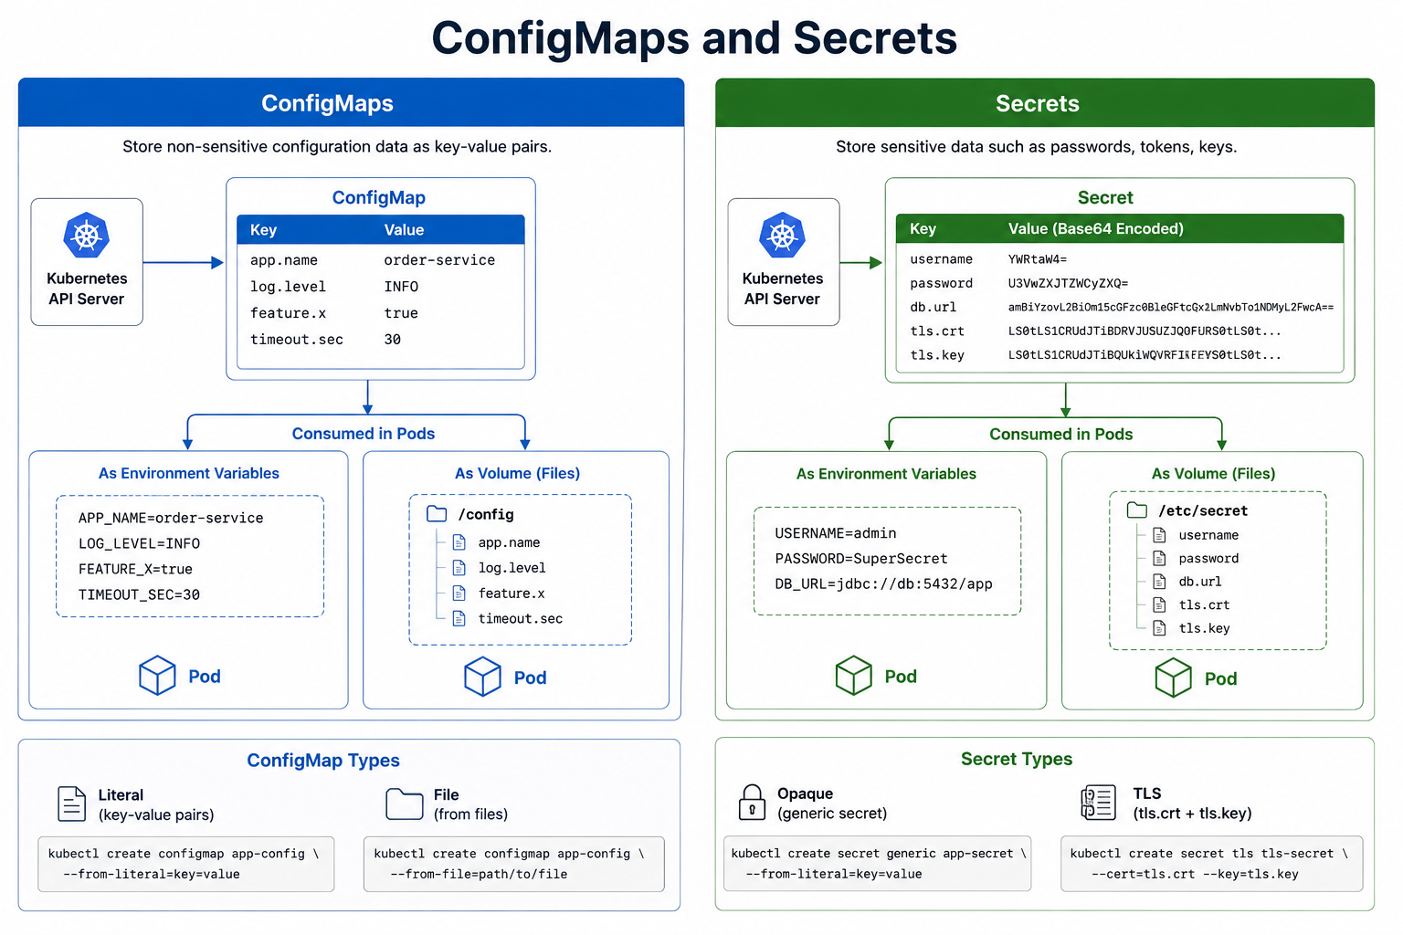
21
© 2026 by Innovation In Software Corporation
Notes:
KEY TALKING POINTS
------------------
- ConfigMaps panel
The table shows plain key-value pairs stored through the API server.
The sample value order-service is a generic e-commerce placeholder, so swap in a banking example when you talk.
The capstone account-config holds SERVER_PORT 8081 and SPRING_DATASOURCE_URL jdbc:postgresql://account-db:5432/account_db.
Everything here is readable by anyone with view access to the project, and that is acceptable because none of it would help an attacker log in.
- Secrets panel
The Value (Base64 Encoded) column is the key teaching moment.
YWRtaW4= decodes to admin, and the password row decodes just as easily, so base64 hides nothing.
Two corrections to the sample.
First, it puts db.url in the Secret, while the lab keeps the JDBC URL in a ConfigMap and only the credentials in the Secret.
Second, the sample environment value jdbc://db:5432/app is not a valid PostgreSQL JDBC URL, which needs the jdbc:postgresql:// prefix.
The tls.crt and tls.key rows show how certificates are stored.
- Consumed in Pods
Both sides show the same two delivery routes.
As environment variables, values are read once when the container starts.
Spring Boot's relaxed binding maps SPRING_DATASOURCE_URL to spring.datasource.url automatically.
As mounted files, each key becomes a file, such as /config/log.level or /etc/secret/password.
Mounted files are updated in the running pod after a while, but environment variables never change until the pod restarts.
The sample USERNAME=admin and PASSWORD=SuperSecret values are exactly what should never appear in a real manifest, a log line, or a screenshot.
- ConfigMap Types and Secret Types
The bottom boxes show imperative creation commands.
A ConfigMap can come from literal values or from files.
A Secret can be generic (Opaque) or TLS with a certificate and key pair.
The commands shown use kubectl, and each has an oc equivalent: oc create configmap, oc create secret generic, and oc create secret tls.
Lab 4 uses declarative YAML with oc apply instead, which keeps the classroom values reviewable.
In a bank, Secret values would come from a vault integration, not from a command typed at someone's desk.
REAL-WORLD EXAMPLES
-------------------
- A bank's online-banking front end might mount a ConfigMap of feature flags as files so it can switch a new payee-verification screen on or off.
A TLS Secret for its internal mutual-TLS certificate is mounted the same way at a separate path.
- When a database password is rotated at a bank that injects credentials as environment variables, running pods keep using the old value until they restart.
Rotation runbooks therefore include a rolling restart of every Deployment that uses the credential.
USE-CASE SCENARIO
-----------------
Use the diagram to sort Lab 4's real configuration.
For Transaction Service, the ConfigMap side of the picture is transaction-config: SERVER_PORT 8082, the transaction_db JDBC URL, kafka:19092, and http://account-service:8081, all delivered through envFrom.
The Secret side is md287-db-secrets: TRANSACTION_DB_USER, TRANSACTION_DB_PASSWORD, and MD287_JWT_SECRET, each mapped with secretKeyRef to a Spring property name.
Ask a participant what would break if MD287_JWT_SECRET were missing.
The service could not validate the JWTs issued by issue-jwt.py, so business APIs would reject every token.
That is a good argument for failing fast at startup.

Slide 23
PERSISTENT VOLUMES AND CLAIMS · SERVICE ACCOUNTS AND ROLE-BASED ACCESS CONTROL
📌
KEY CONCEPTS
✅
ACCESS MODES AND RECLAIM POLICIES
📌
THE FOUR-STEP RBAC MODEL
• Persistent Volume (PV): a piece of cluster storage, provisioned by an admin or dynamically
• Persistent Volume Claim (PVC): a request for storage with a specific size, access mode, and storage class
• StorageClass defines the type of storage and how new volumes are provisioned
1. Identity: a Service Account identifies a process running in a pod
2. RBAC objects: a Role (namespaced) or ClusterRole (cluster-scoped) defines allowed actions
3. Binding: a RoleBinding or ClusterRoleBinding connects the identity to the role
4. Access: the bound role grants access to specific resources (pods, secrets, configmaps)
• RWO (ReadWriteOnce), ROX (ReadOnlyMany), RWX (ReadWriteMany)
• Retain (keep data), Delete (delete PV and storage), Recycle (deprecated)
KEY TAKEAWAY RWO, ROX, and RWX access modes plus Retain/Delete reclaim policies decide who can mount a volume and what happens when a claim is deleted. • Roles define permissions, RoleBindings connect a service account to a role, and the principle of least privilege ties it all together.
22
© 2026 by Innovation In Software Corporation
Notes:
TOPIC 1 OF 2: Persistent Volumes and Claims
------------------------------------------
KEY TALKING POINTS
------------------
- KEY CONCEPTS
A pod's container filesystem disappears when the pod is replaced, so anything durable needs a volume.
Developers write a PersistentVolumeClaim, for example 10Gi, ReadWriteOnce, a given storage class.
The StorageClass then provisions a matching PersistentVolume on demand, such as an Azure managed disk on ARO, and binds it to the claim.
The pod mounts the claim, never the volume directly.
Admins can also pre-create volumes by hand, but dynamic provisioning is the norm.
The capstone Spring Boot services are stateless and use no volumes.
Their state lives in PostgreSQL.
- ACCESS MODES AND RECLAIM POLICIES
ReadWriteOnce means one node can mount the volume read-write, which fits block storage for a single database pod.
ReadOnlyMany allows many nodes to read.
ReadWriteMany allows many nodes to write, which needs file storage such as Azure Files.
Asking for RWX from a block-only storage class leaves the claim stuck in Pending.
Reclaim policy decides what happens after the claim is deleted: Retain keeps the underlying storage for manual recovery, and Delete removes it.
Dynamically provisioned volumes usually default to Delete, so deleting a database's claim can destroy the data.
Recycle is deprecated.
REAL-WORLD EXAMPLES
-------------------
- A bank running PostgreSQL for a loan servicing system on OpenShift would give each database pod its own ReadWriteOnce claim on a block storage class with a Retain policy.
Deleting the claim by mistake then leaves the data recoverable.
- A statement-rendering batch job where several pods write PDFs into a shared output folder needs ReadWriteMany file storage.
Teams that request it from a disk-backed storage class find the claim stuck in Pending until they switch classes.
USE-CASE SCENARIO
-----------------
Ask participants where Lab 4's data actually lives.
Account Service and Transaction Service pods have no volumes.
Deleting a pod loses nothing, because accounts and transactions are in the pre-provisioned account-db and transaction-db.
Those databases are the stateful part, and whoever provisions them owns the claims, access modes, and reclaim policies.
That is why the lab says Postgres and Kafka are platform concerns.
Then pose the what-if: if a participant's database claim used the Delete policy and someone deleted it during cleanup, every synthetic account would be gone.
Stateless services plus carefully managed storage is the pattern.
TOPIC 2 OF 2: Service Accounts and Role-Based Access Control
------------------------------------------
KEY TALKING POINTS
------------------
- THE FOUR-STEP RBAC MODEL
People authenticate as users, while pods run as ServiceAccounts, and every project has a default one.
A Role lists allowed verbs such as get, list, and create on resources within one namespace.
A ClusterRole can be cluster-wide or reused across namespaces.
A binding attaches a role to a subject, and nothing is allowed unless a binding grants it.
Participants hold the built-in edit role in their own project only.
They can create Deployments, Routes, ConfigMaps, and Secrets, but cannot create roles or bindings.
The capstone services never call the Kubernetes API, so their ServiceAccount needs no extra roles.
REAL-WORLD EXAMPLES
-------------------
- A bank's deployment pipeline typically runs as a dedicated ServiceAccount bound to a role that can update Deployments in one application's projects and nothing else.
A compromised pipeline token therefore cannot read Secrets belonging to other lines of business.
- Auditors at regulated firms often ask who can read Secrets in production.
With RBAC, the answer comes from listing the RoleBindings in the production project rather than interviewing teams, and unnecessary edit grants get removed.
USE-CASE SCENARIO
-----------------
Show RBAC working in Lab 4.
A participant runs oc auth can-i create deployments in their project and gets yes, because they hold edit.
They run oc auth can-i create rolebindings and get no, because only admin can do that.
They try oc get pods -n md287-anotheruser and get Forbidden, because they have no binding in that project.
Then connect it to workloads: Account Service pods run as the project's default ServiceAccount, which can pull images from that project's internal registry and nothing more.
A bank's production cluster applies the same model, just with far tighter bindings.

Slide 24
OPENSHIFT IMAGE STREAMS · BUILDS AND BUILDCONFIGS · OPENSHIFT WEB CONSOLE AND CLI
📌
HOW IMAGE STREAMS WORK
📌
BUILD STRATEGIES
✅
TRIGGERS
• An image stream is a named collection of images pulled from a source registry
• Image stream tags point to specific images (e.g., latest, v1.2.0)
• Tags can be set to automatically track updates in the source registry
• Source-to-Image (S2I): uses a builder image to assemble the app -- no Dockerfile needed
• Docker strategy: uses a Dockerfile for full control over build steps
• Custom strategy: runs a custom build script inside the build pod
• Builds can start manually, on a Git webhook, on image change, or on a schedule
📌
WEB CONSOLE
✅
OC CLI
• Browser-based UI to create, view, and manage projects, applications, and resources
• Monitor health, logs, metrics, and events with role-based access built in
• Command-line interface for full control and automation
• Ideal for scripting, CI/CD, and bulk actions across a cluster
KEY TAKEAWAY Applications reference images by image-stream name instead of a full registry path, decoupling deployments from registry locations. • Source-to-Image (S2I) turns Java source straight into a runnable image without a Dockerfile, using a builder image as the template. • Use the console for exploration and troubleshooting; use oc for scripting, CI/CD, and any task that needs to be repeatable.
23
© 2026 by Innovation In Software Corporation
Notes:
TOPIC 1 OF 3: OpenShift Image Streams
-------------------------------------
KEY TALKING POINTS
------------------
- HOW IMAGE STREAMS WORK
An image stream is a set of named tags, each pointing to an exact image digest, whether that image sits in the internal registry or an external one.
It does not necessarily copy or pull anything.
Periodic importing can move a tag when the source changes.
When a participant pushes account-service:1.0.0 into their project's registry path, OpenShift creates an image stream automatically, visible with oc get is.
Two cautions: latest is just a tag name, so promote 1.0.0 and 1.0.1 as the lab does, and a plain Deployment needs extra settings to resolve short image stream names.
REAL-WORLD EXAMPLES
-------------------
- A bank can import an approved Red Hat UBI OpenJDK base image into an image stream in a shared project.
When a patched version is imported after a security advisory, image-change triggers can rebuild or redeploy the dependent services without anyone editing registry paths.
- A release team promoting a payments service can move a prod tag in an image stream from one digest to the next.
Deployments following that tag roll out the exact image that passed testing, identified by digest rather than a mutable name.
USE-CASE SCENARIO
-----------------
In Lab 4 Step 5, push-images.ps1 pushes the participant's images to default-route-openshift-image-registry.apps.aro-md287.centralus.aroapp.io under their project.
Afterwards, oc get is shows account-service and transaction-service image streams with a 1.0.0 tag.
The Deployments, however, are pointed at the full internal pullspec image-registry.openshift-image-registry.svc:5000/<project>/account-service:1.0.0 with oc set image, not at the short image stream name.
Use this to explain both halves: the image stream records what was pushed and at which digest, and the Deployment's image field decides what actually runs.
TOPIC 2 OF 3: Builds and BuildConfigs
-------------------------------------
KEY TALKING POINTS
------------------
- BUILD STRATEGIES
A BuildConfig describes how to turn source into an image inside the cluster.
With Source-to-Image, a builder image such as Red Hat's UBI OpenJDK image compiles the Maven project and packages the JAR, so developers do not need a Dockerfile.
The Docker strategy runs your own Containerfile, which gives you full control, as in Lab 4's multi-stage build with USER md287.
Custom strategy uses a builder image you provide.
It runs with elevated privileges, so it is disabled for ordinary users by default and rare in banks.
Lab 4 builds on the VM and in a Tekton pipeline, not with BuildConfigs.
- TRIGGERS
Builds can start manually with oc start-build, from a Git webhook (GitHub, GitLab, Bitbucket, or generic), when a base image stream tag changes, or when the BuildConfig itself changes.
One correction to the panel: BuildConfigs have no built-in schedule trigger.
A nightly rebuild needs a CronJob that starts the build or a scheduled pipeline run.
The image-change trigger is the most valuable one for banks.
When a patched base image arrives, every dependent application image can be rebuilt without waiting for a code commit.
REAL-WORLD EXAMPLES
-------------------
- A bank's platform team might offer S2I as the paved road for internal Spring Boot APIs.
Teams push code, and the approved builder image produces consistent images, so hundreds of services share one scanned base image rather than hundreds of hand-written Dockerfiles.
- After a Java runtime vulnerability is announced, a bank using image-change triggers updates the base builder image once.
Rebuilds then start automatically for the account, card, and loan services that depend on it, and each image is rescanned before promotion.
USE-CASE SCENARIO
-----------------
Compare Lab 4's approach with the BuildConfig route.
In the lab, participants run docker build on the VM with a multi-stage Containerfile, using Lab 3 solution code as context, and then walk through a prepared pipeline that adds a vulnerability gate, an SBOM, and signature verification.
A team could instead create a Docker-strategy BuildConfig pointing at the same Containerfile, with a Git webhook trigger, so every merge builds inside the cluster.
Ask the room which they would choose for Account Service, and why a scan gate belongs after the build either way.
The strategy only changes where the build runs.
TOPIC 3 OF 3: OpenShift Web Console and CLI
------------------------------------------
KEY TALKING POINTS
------------------
- WEB CONSOLE
The console calls the same API with the user's own permissions, so participants see only their md287-<username> project.
Nothing is hidden by the UI itself; RBAC decides what appears.
It is the fastest way to see a pod's events, why a probe failed, container logs, and CPU and memory graphs from the built-in monitoring stack.
The classroom console is at console-openshift-console.apps.aro-md287.centralus.aroapp.io.
Its Copy login command menu also gives a token for oc login, which is handy when password login is awkward.
- OC CLI
oc does everything the console does and more, and it can be scripted, reviewed, and repeated.
Lab 4 is almost entirely oc: login, project, apply, set image, set env, rollout status, rollout undo, and get route with a jsonpath query.
Pipelines use the same commands with a ServiceAccount token instead of a person.
oc whoami -t prints the current token, which Lab 4 uses to log docker in to the cluster registry.
Participants need an oc 4.x client that matches the cluster version.
REAL-WORLD EXAMPLES
-------------------
- During a production incident on a bank's payments platform, an engineer might use the console's events and metrics views to spot a pod stuck restarting after a bad config change.
The fix itself goes through a reviewed manifest applied by the pipeline with oc.
- Change-management rules at many banks require production changes to be repeatable and auditable.
Teams therefore turn manual console clicks from lower environments into scripted oc or pipeline steps before a change reaches production.
USE-CASE SCENARIO
-----------------
Pair the two tools in Lab 4.
When a participant's account-service pod shows ImagePullBackOff, send them to the console first.
The pod's Events tab shows the pull failing for md287/account-service:1.0.0, because the manifest still has the local image name.
The fix is then a repeatable oc sequence: run push-images.ps1, then oc set image to the internal registry pullspec, then oc rollout status.
The console made the diagnosis quick, and oc made the fix precise and easy to paste into a runbook.
That is the division of labor the key takeaway describes.

Slide 25
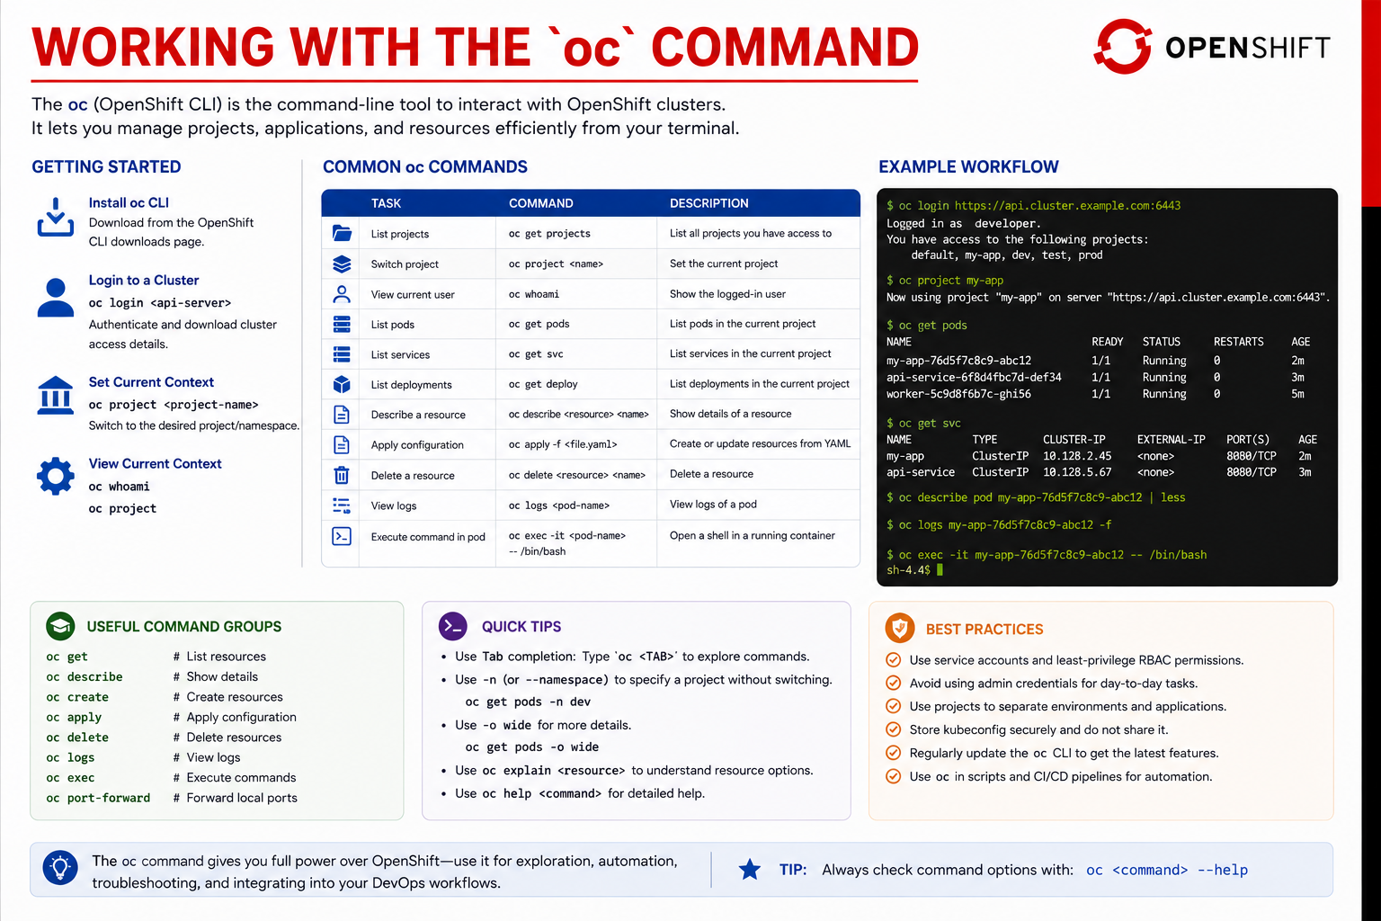
24
© 2026 by Innovation In Software Corporation
Notes:
KEY TALKING POINTS
------------------
- COMMON OC COMMANDS
Five commands cover most of Lab 4.
oc get projects confirms you see your own project, and only yours.
oc project md287-<username> sets the default so later commands target it.
oc get pods shows status, readiness, and restart count, which is the first place to look.
oc logs <pod-name> shows application output, and in the lab that output should include correlationId= and never Authorization.
oc apply -f <file.yaml> creates or updates resources from the manifests.
The lab adds -n $PROJECT to every apply, so nothing lands in the wrong project.
- Example Workflow terminal
The terminal shows a realistic sequence: log in, switch project, list pods and services, describe a pod, follow logs with -f, and open a shell with oc exec.
Adjust it for class.
The project is md287-<username>, not my-app.
The capstone ports are 8081 and 8082, not 8080.
The last command, oc exec -it <pod> -- /bin/bash, fails on the Lab 4 images, because they are built on Alpine and have no bash.
Use /bin/sh instead.
The terminal's project list also shows several projects, while participants will see only one.
- Quick Tips and Useful Command Groups
Tab completion saves typing and catches typos in resource names.
The -n flag targets a namespace without switching, and -o wide adds node and IP columns.
oc explain deployment.spec.strategy shows field documentation right from the cluster, which is quicker than searching online.
Beyond the command groups shown, oc describe is the most useful for troubleshooting, because the Events section at the bottom explains image pull failures, probe failures, and scheduling problems in plain language.
oc port-forward lets you reach a pod without creating a Route.
- Best Practices
The best practices panel is about protecting access.
Use ServiceAccounts and least privilege for automation, never your personal admin credentials.
Keep your kubeconfig private, because it holds a live token.
Separate environments with projects, keep oc up to date and matched to the cluster, and put commands into scripts and pipelines.
In class that means never sharing your oc login password or token with another participant, even to unblock them quickly.
Get the instructor instead.
REAL-WORLD EXAMPLES
-------------------
- A support engineer at a bank investigating a slow statement-download API might run oc get pods -o wide to see whether the restarting pods share one node, then oc describe pod to read eviction events.
Together these point to a node memory problem rather than an application bug.
- Bank platform teams often give application teams a short runbook of approved oc commands, such as get, describe, logs, rollout status, and rollout undo.
Engineers under incident pressure then use safe, read-mostly commands instead of improvising deletes.
USE-CASE SCENARIO
-----------------
A participant's Transaction Service pod is Running but never Ready.
Walk the sheet in order.
oc get pods shows 0/1 READY.
oc describe pod shows the readiness probe on /actuator/health/readiness failing.
oc logs shows a connection refused error to kafka:19092.
They check the ConfigMap with oc get cm transaction-config -o yaml, then confirm the backing service with oc get svc kafka and find it missing in their project.
Now they have a precise message for the instructor, backed by evidence.
Five commands from this sheet turned 'it does not work' into a diagnosis.

Slide 26
DECLARATIVE RESOURCE MANIFESTS · DEPLOYING SPRING BOOT TO OPENSHIFT
📌
KEY PRINCIPLES
✅
APPLY AND MANAGE
📌
THE DEPLOYMENT FLOW
• Declare, don't imperatively manage -- describe desired state, let the platform enforce it
• Consistent, repeatable: manifests are version-controlled, reviewable, and reusable
• Idempotent: applying the same manifest multiple times results in the same state
• oc apply -f my-app.yaml to create or update; oc diff -f to preview changes first
1. Prepare app: externalise configuration, add health probes, and produce a runnable JAR
2. Build image: layer the JAR into a container that runs as a non-root user
3. Push image: publish to a registry with an immutable, versioned tag
4. Deploy: create the Deployment so OpenShift schedules and supervises the pods
5. Expose: add a Service for in-cluster traffic and a Route for external access
6. Access: verify through the Route, then confirm probes and logs look healthy
• OpenShift handles scaling, health checks, rolling updates, and high availability automatically
KEY TAKEAWAY Applying the same manifest twice produces the same result every time -- that idempotency is what makes GitOps and CI/CD pipelines trustworthy. • Source-to-Image, a Docker image, or a BuildConfig are three different paths to the same destination: a running, exposed Spring Boot service.
25
© 2026 by Innovation In Software Corporation
Notes:
TOPIC 1 OF 2: Declarative Resource Manifests
------------------------------------------
KEY TALKING POINTS
------------------
- KEY PRINCIPLES
Declarative means you describe the end state, such as one account-service replica with these probes and limits, and controllers keep working to reach it.
You do not write the steps.
Because manifests are text in Git, they get code review, history, and a clear record of who changed what, which banks need for audit.
Idempotency is what makes re-running safe: applying 10-account.yaml a second time changes nothing and reports unchanged, so a pipeline can apply the whole folder on every run without special cases.
- APPLY AND MANAGE
oc apply creates a resource if it is missing and updates only the fields that changed if it exists.
oc diff -f shows what would change before you commit to it, which works as a free review step in production.
Order matters for dependencies.
Lab 4 applies 01-configmap and 02-secret before 10-account and 20-transaction, so pods do not start before their configuration exists.
Also point out the drift problem: Lab 4's oc set image and oc set env are imperative, so in a real GitOps flow those changes would be committed to the manifests.
REAL-WORLD EXAMPLES
-------------------
- A bank using a GitOps tool such as Argo CD for its card-services projects keeps every Deployment, Route, and ConfigMap in Git.
If someone edits a production Deployment by hand, the tool reports drift and restores the reviewed version.
- Before a change window, a release engineer at a bank can run oc diff against production for the week's merged manifests and attach the output to the change ticket, so approvers see exactly which fields will change.
USE-CASE SCENARIO
-----------------
In Lab 4 Step 5 the participant applies four files in order.
Ask them to run the ConfigMap apply again: the output says unchanged, which shows idempotency live.
Next, have them edit account-config to change a value locally and run oc diff -f first to see the one-line difference, then apply.
Finally, point out that after Step 7's oc set env, the live Deployment no longer matches 10-account.yaml.
Running oc diff -f openshift/10-account.yaml shows INFO_APP_VERSION and the image field differing from Git.
That is configuration drift, and it is exactly why banks put manifests under GitOps control.
TOPIC 2 OF 2: Deploying Spring Boot to OpenShift
------------------------------------------
KEY TALKING POINTS
------------------
- THE DEPLOYMENT FLOW
Map each step to Lab 4.
Prepare: Lab 3 code already has health probe endpoints enabled and reads configuration from environment variables.
Build: a multi-stage Containerfile with USER md287.
Push: push-images.ps1 sends 1.0.0 to the cluster registry.
Deploy: oc apply 10-account.yaml.
Expose: the same file defines the Service and edge Route.
Access: readiness returns 200 through the Route.
Temper the final bullet: health checks happen only if probes are defined, autoscaling needs an autoscaler, and high availability needs more than one replica.
The lab uses one.
REAL-WORLD EXAMPLES
-------------------
- A bank onboarding a new customer-notification service onto OpenShift would typically need the same six steps signed off.
Configuration is external, probes are present, the image is non-root and scanned, the tag is immutable, and a smoke test runs through the Route before the change is marked complete.
- A team that skipped step one and kept a hard-coded database host in its JAR would find the image works only in one environment.
Moving to dev, test, and prod projects means rebuilding per environment, which breaks build once, deploy many.
USE-CASE SCENARIO
-----------------
Tell the Lab 4 story as six steps.
A participant confirms Lab 3's Account Service exposes liveness and readiness endpoints.
They build md287/account-service:1.0.0 and confirm with docker run --entrypoint id that it runs as md287, not root.
They push it to their project's registry path.
They apply the ConfigMap, Secret, and 10-account.yaml, then use oc set image to point at the internal pullspec.
The Service and edge Route come from the same manifest.
Finally, curl.exe against the Route's readiness endpoint returns 200.
Note that the lab applies manifests before pushing, so an ImagePullBackOff before oc set image is expected, not a failure.

Slide 27
CONFIGURING RUNTIME ENVIRONMENTS · RESOURCE REQUESTS AND LIMITS
📌
THREE CONFIGURATION SOURCES
✅
BEST PRACTICES
📌
QUALITY OF SERVICE CLASSES
• ConfigMaps: non-sensitive configuration
• Secrets: sensitive data (encrypted)
• Environment variables: runtime overrides and simple values
• Externalize all configuration -- no hard-coded values
• Validate configuration on startup and fail fast when invalid
• Guaranteed: requests == limits for CPU and memory -- highest priority, least likely to be evicted
• Burstable: requests < limits -- medium priority
• BestEffort: no requests or limits set -- lowest priority, most likely to be evicted
KEY TAKEAWAY Same image, different configuration -- the twelve-factor principle that keeps a Spring Boot service portable across every environment. • Guaranteed, Burstable, and BestEffort quality-of-service classes decide which pods get evicted first when a node runs out of resources.
26
© 2026 by Innovation In Software Corporation
Notes:
TOPIC 1 OF 2: Configuring Runtime Environments
------------------------------------------
KEY TALKING POINTS
------------------
- THREE CONFIGURATION SOURCES
One correction first: the slide labels Secrets as encrypted.
By default they are only base64-encoded.
Encryption at rest is a separate cluster setting, and protection really comes from RBAC.
The lab uses all three sources.
account-config supplies SERVER_PORT and the JDBC URL through envFrom.
md287-db-secrets supplies passwords and the JWT key through secretKeyRef.
Plain env entries set SPRING_PROFILES_ACTIVE=openshift and INFO_APP_VERSION.
Spring Boot's relaxed binding turns SPRING_DATASOURCE_URL into spring.datasource.url, and environment variables override application.yml.
- BEST PRACTICES
Externalize everything that differs between environments, including hosts, ports, credentials, and feature flags, so one image moves from dev to prod unchanged.
That is the twelve-factor config principle.
Fail fast means the service refuses to start when required configuration is missing or invalid.
In Spring Boot, a @ConfigurationProperties class annotated with @Validated does this.
A pod that crashes at startup with a clear message is far easier to diagnose than one that starts and fails on the first customer request.
The lab's JWT secret, for example, must be at least 32 bytes for HS256.
REAL-WORLD EXAMPLES
-------------------
- A bank's wire transfer service uses one image in test and production.
Test points at a simulated payment network through its ConfigMap, and production points at the real endpoint, so the binary that passed testing is exactly the binary that runs in production.
- A lending service that validates its credit-bureau timeout at startup refuses to start when someone sets the value to zero by mistake.
The deployment stalls visibly in the pipeline instead of silently failing every loan application.
USE-CASE SCENARIO
-----------------
Lab 4 shows the twelve-factor idea twice.
On the VM, Docker Compose runs md287/account-service:1.0.0 against local Postgres on host port 5433.
On ARO, the same image runs with account-config pointing at jdbc:postgresql://account-db:5432/account_db and credentials from md287-db-secrets.
Nothing was rebuilt.
Then describe a failure: if a participant misspells MD287_JWT_SECRET in the Secret, the service cannot validate tokens.
Ideally it refuses to start, showing up as a restarting pod with a clear log line, rather than returning 401 to every teller request.
TOPIC 2 OF 2: Resource Requests and Limits
------------------------------------------
KEY TALKING POINTS
------------------
- QUALITY OF SERVICE CLASSES
Requests are what the scheduler reserves when placing a pod.
Limits are the hard ceiling.
A container over its CPU limit is slowed down, and one over its memory limit is killed and restarted as OOMKilled.
Guaranteed requires every container to set equal CPU and memory requests and limits.
Burstable covers pods with some requests or limits that do not meet that rule.
BestEffort sets none and is first to go under memory pressure.
The lab Deployments request 100m CPU and 256Mi memory, with limits of 1 CPU and 512Mi, which makes them Burstable.
REAL-WORLD EXAMPLES
-------------------
- A bank might run its real-time card authorisation pods as Guaranteed with equal requests and limits, so they are the last to be evicted.
Overnight reporting jobs on the same cluster run as Burstable or BestEffort and give way first under pressure.
- A Java service deployed with a 512Mi memory limit but JVM heap settings sized for a larger machine will be OOMKilled repeatedly.
Teams fix it by letting the JVM size its heap from the container limit, for example with MaxRAMPercentage.
USE-CASE SCENARIO
-----------------
Use the lab numbers.
Account Service requests 100m CPU and 256Mi and is limited to 1 CPU and 512Mi.
At startup, Spring Boot and Flyway can burst toward the CPU limit, which is fine for a Burstable pod.
Now ask what happens if a participant loads Account Service with many requests and memory approaches 512Mi.
The container is OOMKilled, the RESTARTS count rises, and oc describe pod shows the reason.
Then ask the design question for production: should Risk Assessment scoring on Day 5 be Guaranteed?
For a latency-sensitive decision in the payment path, a bank would likely say yes.

Slide 28
LIVENESS, READINESS, AND STARTUP PROBES · HORIZONTAL POD AUTOSCALING · ROLLING DEPLOYMENTS
📌
THE THREE PROBE TYPES
✅
SPRING BOOT EXAMPLE ENDPOINTS
📌
HOW HPA WORKS
• Liveness: is the container running? Failure restarts it
• Readiness: is it ready for traffic? Failure removes it from service endpoints
• Startup: has the app finished starting? Disables liveness/readiness until it succeeds
• /actuator/health/liveness and /actuator/health/readiness
• Metrics Server collects CPU/memory/custom metrics from pods
• HPA Controller compares metrics to target values and decides the desired replica count
• The Deployment is adjusted to match -- more pods handle more traffic, fewer save resources
📌
HOW A ROLLING UPDATE WORKS
✅
ROLLBACK
• A new pod with the new version is created; an old pod is terminated once the new one is ready
• The process repeats until all old pods are replaced -- traffic is always served
• oc rollout undo deployment/<name> reverts to the previous revision with one command
KEY TAKEAWAY A startup probe protects a slow-starting Spring Boot app from being killed by liveness checks before it's even finished initializing. • oc scale changes replicas manually; a HorizontalPodAutoscaler does the same thing continuously, in response to real load. • maxUnavailable and maxSurge control exactly how aggressively the rollout proceeds, balancing speed against risk.
27
© 2026 by Innovation In Software Corporation
Notes:
TOPIC 1 OF 3: Liveness, Readiness, and Startup Probes
------------------------------------------
KEY TALKING POINTS
------------------
- THE THREE PROBE TYPES
Liveness asks whether the process is stuck beyond recovery, and failing it gets the container restarted.
Readiness asks whether the pod can take traffic right now, and failing it takes the pod out of Service endpoints without a restart.
Startup runs first and disables the other two until it passes.
That matters for Spring Boot, where Flyway migrations can make startup slow.
The lab's startup probe allows 30 failures five seconds apart, up to about 150 seconds.
Then liveness runs every 15 seconds and readiness every 10.
- SPRING BOOT EXAMPLE ENDPOINTS
Actuator provides these two health groups when management.endpoint.health.probes.enabled is true, which Lab 3 already sets, and Spring Boot also turns them on automatically when it detects Kubernetes.
Lab 4's manifests point startup and liveness at /actuator/health/liveness and readiness at /actuator/health/readiness, on 8081 or 8082.
Keep external dependencies out of liveness.
If the database blips and liveness checks it, every pod restarts together and makes the outage worse.
Dependency checks belong in readiness, if anywhere.
These endpoints stay public while business APIs require a JWT.
REAL-WORLD EXAMPLES
-------------------
- When a bank's core account database fails over, account inquiry pods should go unready and stop receiving traffic, letting the gateway return a controlled error.
If liveness included the database check, every pod would restart repeatedly and slow the recovery.
- A large Spring Boot loan application service that takes a long time to warm caches at startup kept getting killed by an aggressive liveness probe.
Adding a startup probe with a generous failure threshold stopped the restart loop without weakening liveness once the service was running.
USE-CASE SCENARIO
-----------------
After Lab 4 Step 5, have a participant watch oc get pods -w while Account Service starts on ARO.
The pod shows Running but 0/1 READY while Flyway runs, and the startup probe is still in its grace period.
Once readiness passes it flips to 1/1, and only then does curl through the Route return 200.
Then run a thought experiment: without the startup probe, and with a strict liveness setting, the kubelet might restart the container in the middle of a migration, leaving it in a restart loop.
That is the failure the takeaway describes.
TOPIC 2 OF 3: Horizontal Pod Autoscaling
----------------------------------------
KEY TALKING POINTS
------------------
- HOW HPA WORKS
The autoscaler reads CPU and memory usage from the cluster's resource metrics API, which OpenShift's monitoring stack provides.
CPU utilization is measured against the pod's request, so an autoscaler cannot work without requests set.
Custom metrics such as Kafka consumer lag need extra tooling, for example Red Hat's Custom Metrics Autoscaler operator.
You set minimum and maximum replicas and a target, for example oc autoscale deployment/account-service --min=2 --max=5 --cpu-percent=70.
Once an autoscaler owns a Deployment, a manual oc scale is soon overridden.
Adding pods does not help if the database cannot handle the extra connections.
REAL-WORLD EXAMPLES
-------------------
- A bank's balance inquiry API sees peaks on paydays and at the start of the month.
An autoscaler with a sensible minimum keeps a baseline of pods, adds more as CPU rises during the morning mobile-app peak, and scales back down afterwards without anyone watching.
- A payment event consumer scaled on consumer lag stops improving once pod count reaches the Kafka topic's partition count.
Extra consumers in the same group sit idle, so the team has to add partitions rather than pods.
USE-CASE SCENARIO
-----------------
Picture a busy day for the capstone.
Transaction Service receives a burst of transactions to screen.
With an autoscaler at 70 percent CPU of its 100m request, it grows from two pods toward its maximum.
Each new pod passes readiness and joins the transaction-service Service.
But each pod also opens its own database connection pool, with HikariCP's default of 10 connections, and calls Account Service for every transaction.
Ask the room what happens to transaction-db and Account Service.
Scaling one service moves the pressure to its dependencies, so bank capacity plans cover the whole call chain, not one Deployment.
TOPIC 3 OF 3: Rolling Deployments
---------------------------------
KEY TALKING POINTS
------------------
- HOW A ROLLING UPDATE WORKS
When the pod template changes, the Deployment creates a new ReplicaSet and shifts pods over gradually.
maxSurge is how many extra pods can exist during the rollout, and maxUnavailable is how many can be missing.
Both default to 25 percent.
With the lab's single replica, that rounds to one surge pod and zero unavailable, so the new pod must pass readiness before the old one stops.
Readiness is what makes a rollout safe.
Without a readiness probe, traffic can reach a pod that is still starting.
- ROLLBACK
oc rollout undo scales the previous ReplicaSet back up and the current one down, using the same rolling mechanics.
oc rollout history lists the revisions, and --to-revision picks a specific one.
Be clear about the limits.
Undo restores only the pod template: image, env, probes, and resources.
It does not undo edits to a ConfigMap or Secret.
It cannot undo database migrations either, and Flyway migrations only move forward.
So banks design schema changes to stay compatible with the previous version before relying on rollback.
REAL-WORLD EXAMPLES
-------------------
- A bank releasing a new version of its card-controls API during business hours uses a rolling update with maxUnavailable set to zero, so capacity never drops.
If the new version's error rate climbs, the on-call engineer runs oc rollout undo instead of debugging live.
- A team that renamed a database column in the same release as its code change found that rolling back the Deployment did not help, because the old code expected the old column.
Banks now split such changes into expand and contract releases.
USE-CASE SCENARIO
-----------------
Lab 4 Step 7 is this slide in action.
The participant runs oc set env deploy/account-service INFO_APP_VERSION=1.0.1.
A second ReplicaSet appears, a new pod starts and passes readiness, and then the old pod terminates.
oc rollout status confirms, and /actuator/info through the Route shows 1.0.1.
Now pretend 1.0.1 is a bad Friday release.
oc rollout undo brings back the 1.0.0 template, the status check completes, oc rollout history shows more than one revision, and /actuator/info returns 1.0.0.
The whole rollback is a few commands, rehearsed before it is ever needed in production.

Slide 29
BLUE-GREEN DEPLOYMENTS · CANARY DEPLOYMENTS · ROLLBACKS AND DEPLOYMENT HISTORY
📌
HOW BLUE-GREEN WORKS
📌
HOW CANARY DEPLOYMENT WORKS
• Deploy the new version (Green) alongside the current one (Blue), fully in parallel
• Validate Green thoroughly, then switch traffic from Blue to Green instantly
• Retire Blue once Green proves stable -- or revert instantly if it doesn't
• Deploy the new version alongside the stable one, routing only a small percentage of traffic to it
• Monitor metrics, logs, and user feedback; gradually increase traffic if healthy
• Automatic or manual rollback if errors or performance issues are detected
📌
HOW ROLLBACKS WORK
✅
USEFUL COMMANDS
• A new version is deployed; monitoring detects errors or performance problems
• Rollback is triggered via CLI, web console, or API; traffic routes back to the last stable version
• oc rollout history deployment/<name> to view revisions
• oc rollout undo deployment/<name> --to-revision=<n> to roll back to a specific one
KEY TAKEAWAY Green gets fully validated with real traffic patterns before the switch, and Blue stays on standby as an immediate rollback target. • 5% traffic to the canary, monitor error rate and latency, then gradually increase to 25%, 50%, and 100% -- or roll back at any step. • oc rollout undo deployment/<name> reverts to the last stable revision in seconds, without rebuilding a single container.
28
© 2026 by Innovation In Software Corporation
Notes:
TOPIC 1 OF 3: Blue-Green Deployments
------------------------------------
KEY TALKING POINTS
------------------
- HOW BLUE-GREEN WORKS
Blue-green means two complete environments sit side by side.
Blue is the version serving customers now.
Green is the next version, already running, already probed, already seeing real traffic patterns on a test or shadow path.
The switch is a routing change, not a rebuild: move the Service or Route from Blue to Green in one step.
If Green misbehaves, route back to Blue, which never left.
That is why rollback is instant.
Lab 4 does not stand up a second full environment.
It practices the same idea with a rolling update and oc rollout undo, keeping the last ReplicaSet as the standby.
REAL-WORLD EXAMPLES
-------------------
- A retail bank preparing a weekend card-authorisation change often keeps yesterday's stack running while the new stack is validated against replayed traffic.
Traffic flips only after health, latency, and decline-rate checks look right, and the old stack stays warm as the undo path.
- Enterprise platform teams use blue-green when a release changes more than one service at once, such as a statement-generation API plus its schema.
Keeping the previous environment intact avoids a long rebuild if the cutover fails.
USE-CASE SCENARIO
-----------------
The capstone team wants a zero-downtime Account Service cutover from 1.0.0 to 1.0.1.
In a true blue-green design they would run a second Deployment, prove liveness and readiness on port 8081 through the Green Route, then retarget the Service.
Lab 4 is smaller and more honest about classroom time: participants bump INFO_APP_VERSION, watch the rolling update, then run oc rollout undo and confirm /actuator/info returns 1.0.0.
Same recovery idea, one environment.
Transaction Service on 8082 stays on its last good image while Account is rehearsed.
TOPIC 2 OF 3: Canary Deployments
--------------------------------
KEY TALKING POINTS
------------------
- HOW CANARY DEPLOYMENT WORKS
A canary ships the new version next to the stable one and sends only a slice of live traffic to it, often starting near five percent.
Operators watch error rate, latency, and logs on that slice, then raise the share to a quarter, a half, and finally all of it.
Any step can reverse the split.
Unlike blue-green, most customers stay on the proven version while a few become the proof.
Lab 4 does not implement weighted routing.
The monitoring habit still applies: after a rollout, check Actuator readiness and logs before you call the change done.
REAL-WORLD EXAMPLES
-------------------
- A mobile-banking login change is a classic canary: a small share of sessions hits the new pods while the rest stay on the last release.
If error rate or login latency rises on the canary, traffic is pulled back before most customers notice.
- Enterprise API gateways and service meshes support percentage-based routing for this pattern.
Platform teams raise the weight only after Prometheus-style error and latency signals stay inside the agreed band.
USE-CASE SCENARIO
-----------------
Imagine promoting Transaction Service 1.0.1 after a Kafka consumer tweak.
A canary would send a few POST /api/v1/transactions requests to the new pods while Account Service on 8081 still answers the rest.
If RECEIVED events stall or readiness fails, the split snaps back.
In class, participants cannot split Route traffic that way.
They still get the decision loop: deploy, watch probes and logs, then either keep going or run oc rollout undo.
The Tekton walk later is conceptual; the rollback command is the required rehearsal.
TOPIC 3 OF 3: Rollbacks and Deployment History
------------------------------------------
KEY TALKING POINTS
------------------
- HOW ROLLBACKS WORK
OpenShift keeps a revision every time a Deployment changes image, env, or template.
When monitoring shows errors or a readiness probe never returns 200, you do not rebuild the JAR.
You point the Deployment back at the last healthy revision.
The previous ReplicaSet still has the 1.0.0 pods' spec, so traffic returns to a known image in seconds.
Trigger it from oc, the web console, or the API.
Lab 4 Step 7 is this mechanic: set INFO_APP_VERSION to 1.0.1, confirm /actuator/info, then undo and confirm 1.0.0 again.
- USEFUL COMMANDS
oc rollout history deployment/account-service lists revisions and why they were created.
oc rollout undo deployment/account-service returns to the previous revision.
Add --to-revision=n when you must skip past a bad one to an older known-good.
Pair both with oc rollout status so you wait until the ReplicaSet is ready, not just until the command returns.
Practice on Account Service first; Transaction Service on 8082 uses the same two commands.
History is why you never need to docker build to recover a Friday release.
REAL-WORLD EXAMPLES
-------------------
- Bank change windows often require a named rollback command in the runbook before the window opens.
Redeploy yesterday's image tag, or undo the last Deployment revision, is a path an on-call engineer can run without waiting for a rebuild.
- Enterprise teams treat revision history as audit evidence: who rolled what, when, and which image digest went back into service.
That record lives on the Deployment, not in a chat thread.
USE-CASE SCENARIO
-----------------
During Lab 4 the capstone Account Service is live on the assigned OpenShift project, Route ready, probes on Actuator, ConfigMap holding the JDBC URL, Secret holding MD287_JWT_SECRET.
A participant sets INFO_APP_VERSION to 1.0.1 to simulate a release.
/actuator/info on the Route shows the new version.
Then they run oc rollout undo deploy/account-service, wait on rollout status, and read history.
The previous ReplicaSet returns and /actuator/info shows 1.0.0.
Transaction Service stays on 8082 untouched.
That is the rehearsed bank rollback: no Containerfile, no Maven, no new image.

Slide 30
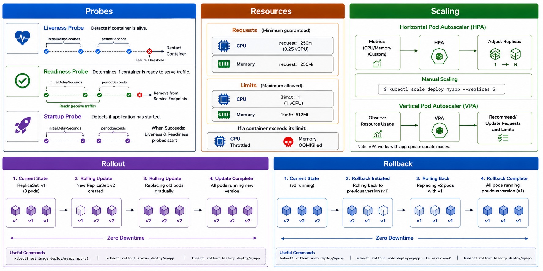
29
© 2026 by Innovation In Software Corporation
Notes:
KEY TALKING POINTS
------------------
- Probes region: liveness, readiness, and startup
Liveness asks whether the process is alive; failure restarts the container after initialDelay and periodSeconds trip the failure threshold.
Readiness asks whether it can take traffic; failure removes the pod from Service endpoints.
Startup asks whether the application has finished booting; only when it succeeds do the other two start, which gives Spring time to initialise.
Lab 4 hits /actuator/health/liveness and /actuator/health/readiness.
The solution YAML also sets a startup probe on the liveness path so a slow first boot does not get killed.
- Resources region: requests and limits
A request is the guaranteed amount the scheduler uses to place the pod.
A limit is the maximum.
CPU over the limit is throttled; memory over the limit is OOM-killed.
The diagram's sample numbers differ from class.
Lab 4 Account and Transaction Deployments request 100m CPU and 256Mi memory, and limit one CPU and 512Mi.
Those values keep a Java 21 JRE from starving its neighbour in the assigned project.
Set both.
A pod with no limit can consume a node; a pod with no request can be packed too tightly.
- Scaling region: HPA, manual scale, and VPA
Horizontal Pod Autoscaler adds or removes replicas from CPU, memory, or custom metrics.
Manual scale is oc scale deploy/account-service --replicas=n; the diagram shows kubectl, and in this course the client is oc.
Vertical Pod Autoscaler recommends or writes new requests and limits from observed usage, and needs an update mode that fits the workload.
Lab 4 does not turn on HPA or VPA.
Replica count lives in the Deployment, and the lesson is that probes and resources must be correct before any autoscaler has a trustworthy signal.
- Rollout region: rolling update with zero downtime
A rolling update creates a new ReplicaSet for v2 and replaces v1 pods gradually until every pod is the new version.
Useful commands on the diagram are kubectl set image, rollout status, and rollout history; say oc instead.
Lab 4 uses oc set env or oc set image, then oc rollout status.
Because readiness gates traffic, a pod that is not ready never receives Account calls on 8081 or Transaction calls on 8082 during the replace.
That is the zero-downtime claim: old Ready pods keep serving until new Ready pods exist.
- Rollback region: undo to a previous revision
Rollback is the same rolling replace in reverse: v2 pods give way to v1 until the previous revision is running.
oc rollout undo deploy/account-service is the Lab 4 required command.
--to-revision picks a specific history entry, and rollout history proves more than one revision exists.
No image rebuild.
After undo, /actuator/info on the Account Route returns version 1.0.0.
Transaction Service on 8082 uses the same history if you bump it.
This panel is the picture for Step 7.
REAL-WORLD EXAMPLES
-------------------
- Card-authorisation platforms keep readiness probes on the authorise path's dependencies so a pod whose database session pool is exhausted is taken out of the Service before customers hit timeouts, while liveness only restarts a truly dead process.
- Enterprise capacity reviews start from requests and limits, not from hope.
A batch job without a memory limit can OOM-kill itself on a shared node and take a neighbouring API with it if the node is overcommitted.
USE-CASE SCENARIO
-----------------
Walk the diagram as the Lab 4 Account Service path.
Multi-stage image md287/account-service:1.0.0 runs as uid 100.
The Deployment sets runAsNonRoot, requests, limits, and the three Actuator probes.
Compose on the VM proves 8081 first.
On OpenShift the Route only goes Ready after readiness returns 200.
A version bump to 1.0.1 is the purple rollout row.
oc rollout undo is the blue rollback row.
Transaction Service mirrors the same fields on 8082.
HPA and VPA stay as the production next step, not today's lab.
The Tekton walk later deploys that same Deployment; it does not replace these controls.

Slide 31
OPENSHIFT LOGGING AND MONITORING · TROUBLESHOOTING PODS AND DEPLOYMENTS
📌 COMMON POD ISSUES
ISSUE | WHAT TO CHECK
Pod Pending | oc describe pod, oc get events
CrashLoopBackOff | oc logs --previous, oc describe pod
Readiness/Liveness failure | oc describe pod, check probe path/port
Volume/Storage issue | oc describe pod, oc get pvc
📌
WHAT GETS COLLECTED
✅
COMMON TOOLS
• Application logs, container/pod logs, cluster and node metrics
• API server and audit logs, events and alerts
• Prometheus (metrics), Grafana (dashboards), Elasticsearch (log storage/search), Alertmanager (alert routing)
KEY TAKEAWAY Fluentd/Fluent Bit ship logs to Elasticsearch, Prometheus scrapes metrics, and Grafana/Kibana turn both into dashboards and alerts. • oc describe pod gives the high-level view first; events almost always contain the most accurate clue about what actually failed.
30
© 2026 by Innovation In Software Corporation
Notes:
TOPIC 1 OF 2: OpenShift Logging and Monitoring
------------------------------------------
KEY TALKING POINTS
------------------
- WHAT GETS COLLECTED
A cluster gathers more than application println output.
Application logs carry correlationId and business outcomes.
Container and pod logs are what oc logs shows.
Node and cluster metrics show CPU, memory, and disk pressure.
API server and audit logs record who changed a Deployment or Secret.
Events explain why a pod is Pending or CrashLoopBackOff.
Alerts are the routed signal that something crossed a threshold.
In Lab 4 you will mostly read pod logs and Actuator metrics; the rest is the platform story that surrounds those two signals in production.
- COMMON TOOLS
Prometheus scrapes metrics, including Micrometer output from Spring Boot Actuator.
Grafana turns those series into dashboards.
Elasticsearch (or Loki in some clusters) stores searchable logs shipped by Fluentd or Fluent Bit.
Alertmanager routes firing alerts to the right on-call path.
Kibana is the usual search UI on an Elasticsearch store.
Do not install this stack in class.
Participants prove the application side: public liveness and readiness, /actuator/metrics with a JWT, and correlationId= in docker logs or oc logs across Account on 8081 and Transaction on 8082.
REAL-WORLD EXAMPLES
-------------------
- Payments operations teams correlate a spike in authorisation latency with pod restarts and node memory pressure.
Metrics come from Prometheus, the restart reason from events, and the customer impact from application logs that already carry a correlation id.
- Enterprise OpenShift estates commonly ship container logs through Fluent Bit into a central store so a security review can search audit events and application logs without logging into individual nodes.
USE-CASE SCENARIO
-----------------
After the capstone services are on OpenShift, a teller reports a stuck transfer.
The operator does not SSH anywhere.
They open the Account Route readiness check, then oc logs on both pods and search for the same correlationId.
Micrometer metrics on Account Service show whether the Account call itself was slow.
That is the classroom slice of this stack.
In a full bank cluster, Fluent Bit would already have those lines in Elasticsearch, Prometheus would scrape the same Actuator meters, and Grafana would show the error-rate panel.
Lab 4 still requires the signals; the shipping layer is conceptual.
TOPIC 2 OF 2: Troubleshooting Pods and Deployments
------------------------------------------
KEY TALKING POINTS
------------------
- COMMON POD ISSUES
Start with oc describe pod and read Events before you guess.
Pending usually means the scheduler cannot place the pod: quota, node pressure, or a missing PersistentVolumeClaim.
CrashLoopBackOff means the process started and died; oc logs --previous shows the last crash, often a bad env var or a root image rejected by runAsNonRoot.
Probe failures mean the path or port is wrong, or Spring is still booting without a startup probe.
Volume issues show as mount errors; oc get pvc confirms the claim bound.
Lab 4's own table adds ImagePullBackOff after a missed push, and a named USER md287 that OpenShift cannot prove is non-root until runAsUser 100 is set.
REAL-WORLD EXAMPLES
-------------------
- A statement-batch pod that stays Pending overnight is often a storage problem: the claim never bound, so the scheduler will not place the pod.
describe and oc get pvc find that faster than reading application logs that do not exist yet.
- CrashLoopBackOff on a payments API after a config change is frequently a missing Secret key.
The previous container log shows a failed datasource URL or a blank password, which is why logs --previous is the second command, not a rebuild.
USE-CASE SCENARIO
-----------------
A participant applies 10-account.yaml and the Account pod never becomes Ready.
They run oc describe pod first.
Events show CreateContainerConfigError: runAsNonRoot plus a non-numeric user md287.
That is the Lab 4 troubleshooting row: keep runAsNonRoot true and set runAsUser 100, the uid printed by docker run --entrypoint id on md287/account-service:1.0.0.
After the fix, probes on /actuator/health/liveness and /actuator/health/readiness go green on 8081.
If the image was never pushed, the event would have been ImagePullBackOff instead, and the fix is tools/push-images.ps1 plus oc set image.

Slide 32
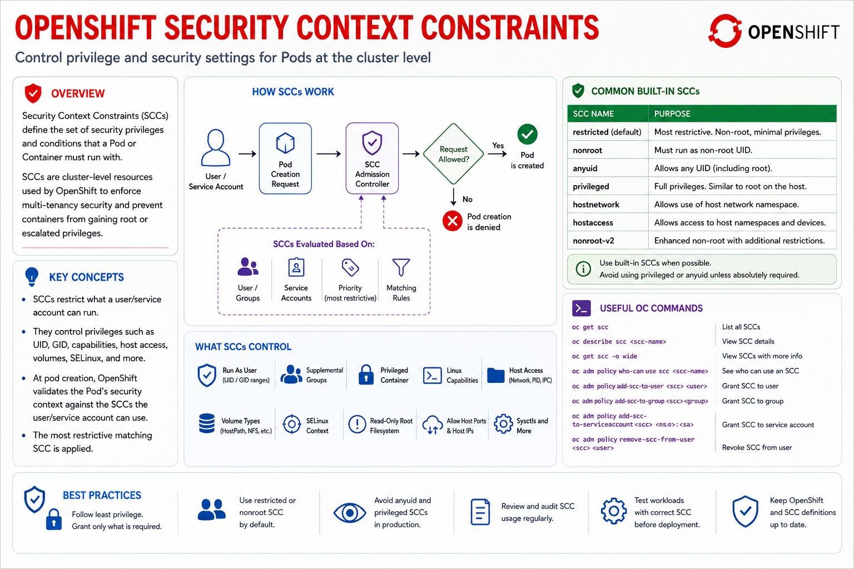
31
© 2026 by Innovation In Software Corporation
Notes:
KEY TALKING POINTS
------------------
- COMMON BUILT-IN SCCS
A Security Context Constraint is the OpenShift rule that decides what a pod is allowed to do.
The most restrictive matching SCC wins.
restricted is the default: non-root, few capabilities, no host namespaces.
nonroot still forbids uid 0 but is slightly less tight.
anyuid lets a container pick any uid, including root, and is a common exception request that should stay rare.
privileged is close to root on the node and is for infrastructure, not a Spring Boot API.
Lab 4 images use USER md287 and the Deployment sets runAsNonRoot true plus runAsUser 100 so the restricted SCC can admit the pod.
REAL-WORLD EXAMPLES
-------------------
- Shared banking clusters almost always default new application projects to the restricted SCC so a careless Containerfile that runs as root never reaches a worker node.
Teams that need anyuid file a justified exception with an expiry.
- Platform operators reserve privileged for node agents and storage plugins, not for a customer-facing account API.
That split is how one team's debug container is kept from becoming a host-level risk.
USE-CASE SCENARIO
-----------------
The capstone Account image is built with a multi-stage Containerfile and USER md287.
On the VM, docker run --entrypoint id prints uid 100, not 0.
On the assigned OpenShift project the Deployment also sets runAsNonRoot true.
If runAsUser is omitted, the restricted SCC cannot prove the named user is non-root and the pod fails with CreateContainerConfigError.
Setting runAsUser 100 admits the pod.
Transaction Service on 8082 uses the same pair.
That is the SCC lesson in Lab 4: the image and the Deployment must both refuse root, or the platform will refuse the deploy.

Slide 33
OPENSHIFT NETWORKING AND NETWORK POLICIES · MANAGING APPLICATION SECRETS
📌 TYPES OF SECRETS
TYPE | EXAMPLE USE
Opaque (generic) | Passwords, tokens, API keys
kubernetes.io/dockerconfigjson | Registry authentication / image pull secrets
kubernetes.io/tls | TLS termination, mTLS
Service Account Token | Pod authentication to the API server
📌
NETWORK POLICY BASICS
• Network Policies define rules for controlling ingress and egress traffic to/from pods
• Applied per namespace and pod selector; if no policy selects a pod, all traffic is allowed
• Ingress rules answer 'who can talk to me?'; egress rules answer 'where can I talk?'
KEY TAKEAWAY Once a NetworkPolicy selects a pod, only traffic matching its rules is allowed -- everything else is silently denied. • Opaque, docker registry, TLS, and service-account-token secrets each cover a different sensitive-data use case in OpenShift.
32
© 2026 by Innovation In Software Corporation
Notes:
TOPIC 1 OF 2: OpenShift Networking and Network Policies
------------------------------------------
KEY TALKING POINTS
------------------
- NETWORK POLICY BASICS
Until a NetworkPolicy selects a pod, OpenShift allows all pod-to-pod traffic in the project.
The moment a policy selects that pod, the default flips: only the listed ingress or egress is allowed, and everything else is dropped with no friendly error.
Ingress answers who may call me.
Egress answers where I may call.
Policies are namespaced and match labels.
Lab 4 does not apply a NetworkPolicy; Account on 8081 and Transaction on 8082 can talk because nothing has selected them yet.
In production you would allow Transaction to reach Account and the databases, and deny the rest.
REAL-WORLD EXAMPLES
-------------------
- A payments project often allows the authorisation pod to reach its database and a fraud API, and denies it from calling payroll or HR services in other namespaces.
The policy is the written least-privilege rule, not a ticket that says please do not connect.
- Enterprise clusters that turn on a default-deny NetworkPolicy for every new project force teams to declare ingress before a Route or Service will actually deliver traffic.
Forgotten policies show up as silent timeouts, not as 403 pages.
USE-CASE SCENARIO
-----------------
After Lab 4, Transaction Service calls Account Service by Service DNS and publishes to kafka:19092 from the ConfigMap.
A later hardening step would add a NetworkPolicy that selects the Account pods and allows ingress only from Transaction pods on 8081, plus egress to account-db.
Transaction pods would be allowed to reach Account, transaction-db, and Kafka, and nothing else.
Until that policy exists, the classroom project is wide open inside the namespace.
Teach the flip: the first policy is the moment silent deny begins, so write the allow rules before you apply it.
TOPIC 2 OF 2: Managing Application Secrets
------------------------------------------
KEY TALKING POINTS
------------------
- TYPES OF SECRETS
Opaque, or generic, Secrets hold passwords, tokens, and API keys.
That is the Lab 4 type: database password and MD287_JWT_SECRET.
kubernetes.io/dockerconfigjson is the image-pull Secret for a private registry; the classroom push script logs into the internal registry so pods can pull.
kubernetes.io/tls holds certificates for Route TLS or mTLS.
A Service Account token is how a pod authenticates to the API server and is usually projected automatically.
Secrets are base64-encoded, not encrypted in the YAML you apply, so treat the file as sensitive and limit who can get secret.
ConfigMaps stay for JDBC URLs and kafka:19092, never for the password.
REAL-WORLD EXAMPLES
-------------------
- A card platform stores the HS256 signing key and the database password in an Opaque Secret, injects them as environment variables, and keeps the JDBC URL in a ConfigMap so a host change does not require rotating credentials.
- Enterprise OpenShift teams attach a dockerconfigjson pull Secret to the default service account when images live in a private registry, so Deployments do not embed registry passwords in the container spec.
USE-CASE SCENARIO
-----------------
In Lab 4 the starter Secret carries MD287_JWT_SECRET and the Postgres passwords.
The ConfigMap carries the JDBC URL and kafka:19092.
Account Service on 8081 and Transaction Service on 8082 both consume those objects as env vars after oc apply.
Business APIs still need a JWT; Actuator liveness and readiness stay public.
If someone puts the JWT key in the ConfigMap, any project member who can read ConfigMaps can mint tokens.
Keep the split.
Image pull uses the internal registry after tools/push-images.ps1, which is the dockerconfigjson story without asking participants to author that Secret by hand.

Slide 34
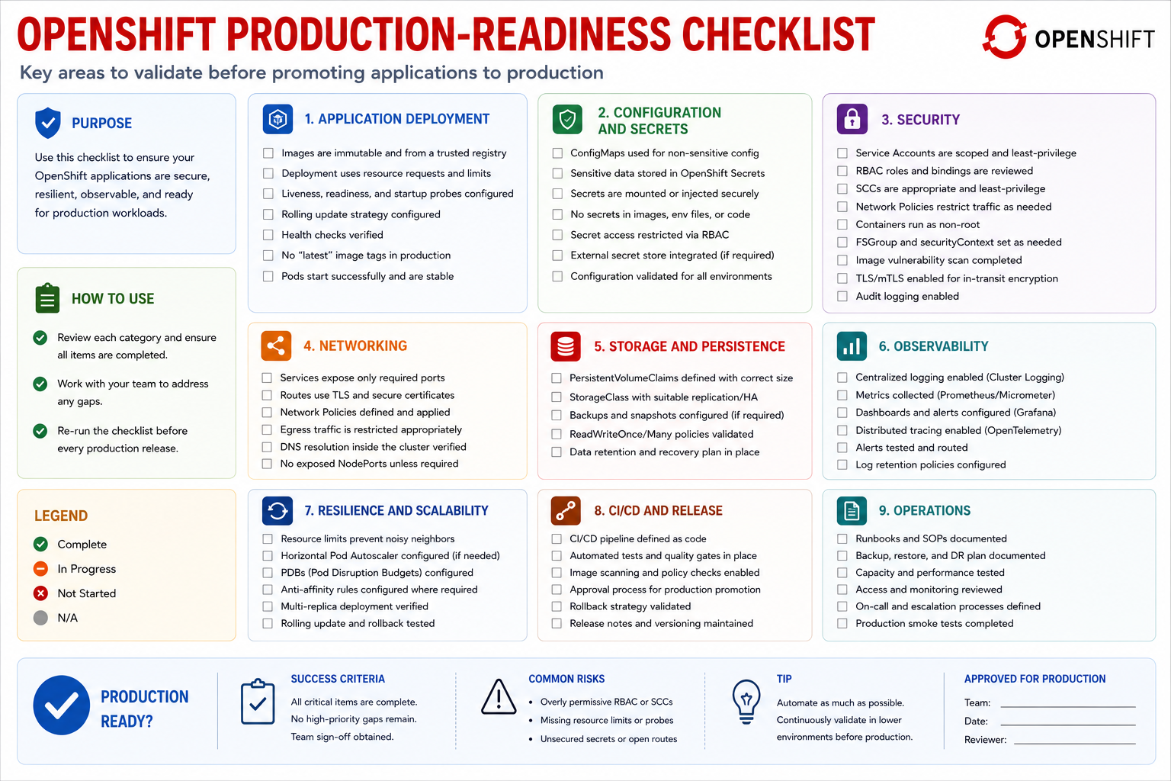
33
© 2026 by Innovation In Software Corporation
Notes:
KEY TALKING POINTS
------------------
- CHECKLIST CATEGORIES (1-5)
These five are the deploy-time bar.
Application deployment means a pinned image, a Deployment, a Service, and a Route that actually answers.
Configuration and secrets means URLs in a ConfigMap and passwords in a Secret.
Security means non-root, restricted SCC, and no credentials in the image.
Networking means Services, Routes, and later NetworkPolicies.
Storage means claims that bound, which the capstone databases already have as platform services.
Lab 4 hits the first four on Account 8081 and Transaction 8082; storage is pre-provisioned as account-db and transaction-db.
- CHECKLIST CATEGORIES (6-9)
Observability is probes, logs with correlationId, and Actuator metrics.
Resilience and scalability is requests, limits, and a replica story you can defend.
CI/CD and release is a replayable pipeline with scan, SBOM, sign, and a human promote in a bank.
Operations is the runbook: how to read history and how to undo.
Lab 4 Step 6 walks the prepared pipeline conceptually through Tekton or tools/run-pipeline-locally.ps1.
Step 7 is operations: oc rollout undo back to 1.0.0.
A service that is merely Running has not finished this list.
REAL-WORLD EXAMPLES
-------------------
- Bank production-readiness reviews commonly walk a similar list before a new microservice is allowed onto the shared cluster: image source, secret handling, network path, probes, and a named rollback.
Missing any one item delays the go-live, not the demo.
- Enterprise SRE handoffs fail when CI/CD is a screenshot of a green pipeline that nobody can replay.
The operations category on this slide is that test: can a different engineer undo last Friday's release from the Deployment history.
USE-CASE SCENARIO
-----------------
Use the nine rows as the Lab 4 close-out.
Account and Transaction images are non-root and tagged 1.0.0.
Manifests apply Deployment, Service, and Route.
ConfigMap versus Secret is correct.
Probes hit Actuator.
Resources are set.
The prepared pipeline produced a passing scan, a failing CRITICAL sample, an SBOM, and a signature command.
oc rollout undo restored 1.0.0.
What is still conceptual: NetworkPolicies, HPA, and a GitOps reconciler.
What is still Day 5: Risk Assessment Service.
The checklist is how you tell a completed lab from a stack that only started.

Slide 35
EXERCISE 4.2 — CONTAINERIZE ACCOUNT SERVICE
Module 10 checkpoint B — Secure non-root image.
🎯
OBJECTIVE
📝
DO THIS
✅
EXPECTED RESULT
• Secure non-root image
• 10 min · ops warmup checkpoint
• Worksheet: curriculum/day-04/exercises/exercise-4.2-containerize-account.md
1. Multi-stage build: Maven compile in builder, JRE runtime in final image
2. USER md287 (non-root). OpenShift also sets runAsNonRoot: true
3. Immutable tag 1.0.0 — not :latest
4. Images are built from Lab 3 solution context — do not recopy Java trees
• You can explain why the runtime user is not root before you run docker build.
• Lab 4 Step 3 recap: multi-stage Containerfile, USER md287, tag md287/account-service:1.0.0.
KEY TAKEAWAY You can explain why the runtime user is not root before you run docker build.
34
© 2026 by Innovation In Software Corporation
Notes:
KEY TALKING POINTS
------------------
- OBJECTIVE
This is the Module 10 ops warmup, about ten minutes, before or inside Lab 4 Step 3.
The goal is not a working cluster yet.
It is a spoken explanation: why the runtime user is not root, before anyone runs docker build.
The worksheet lives at curriculum/day-04/exercises/exercise-4.2-containerize-account.md.
Scope stays on Account Service and, by the same Containerfile pattern, Transaction Service.
No extra services, no OpenShift AI, no recopy of Lab 3 Java trees.
- DO THIS
Walk four decisions.
The Containerfile is multi-stage: Maven 3.9 with Temurin 21 compiles in the builder, and the final image is a JRE plus the JAR.
USER md287 switches off root; OpenShift will also set runAsNonRoot true and, in the solution, runAsUser 100.
Tag md287/account-service:1.0.0, never latest.
The build context is labs/day-03/lab3/solution/account-service, and -f points at the Lab 4 Containerfile.
Transaction Service is the same pattern on port 8082.
Starter files leave the user and EXPOSE lines unfinished on purpose so participants write them.
- EXPECTED RESULT
A participant can say, before the build, that a root runtime is one break-out from host power and that the restricted SCC will often refuse that image.
After the build, docker run --rm --entrypoint id md287/account-service:1.0.0 prints uid 100 and user md287.
docker history shows the Maven stage is gone from the final image.
Lab 4 Step 3 is the recap of that layered image.
Compose on 8081 and the OpenShift deploy come after this checkpoint, not instead of it.
REAL-WORLD EXAMPLES
-------------------
- Shared OpenShift platforms in banks reject application images that run as root.
Teams learn this on the first deploy, when the pod is refused, unless the Containerfile already creates a numeric non-root user.
- Enterprise image reviews look for multi-stage builds so compilers, Maven caches, and source trees never reach the runtime layer that production actually runs on OpenShift.
USE-CASE SCENARIO
-----------------
The capstone Account Service from Lab 3 is the build context.
Participants finish starter/account-service/Containerfile: addgroup and adduser md287, COPY the JAR, USER md287, EXPOSE 8081, tag 1.0.0.
They repeat the idea for Transaction Service on 8082.
That pair of images is what later Compose probes, what tools/push-images.ps1 sends to the internal registry, and what the OpenShift Deployments run with runAsNonRoot.
Exercise 4.2 is the moment they can defend the user line.
The Tekton walk and oc rollout undo come after the image exists and is non-root.

